Slide 1
Canadian Lighthouses
New Brunswick
Kris E Roberts

Slide 2
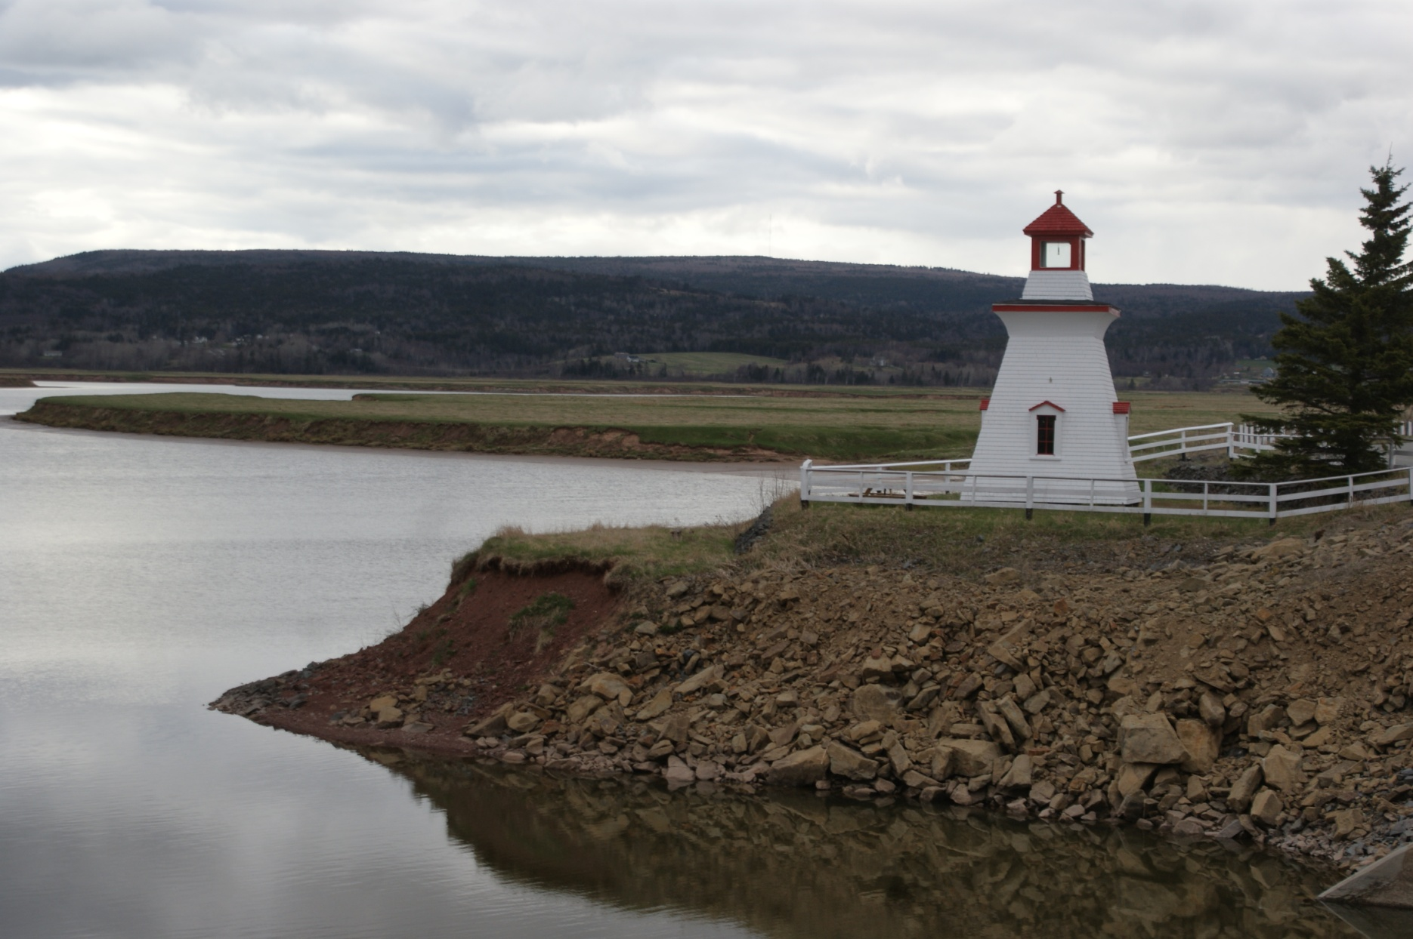
Can-NB-Anderson Hollow Light

Slide 3
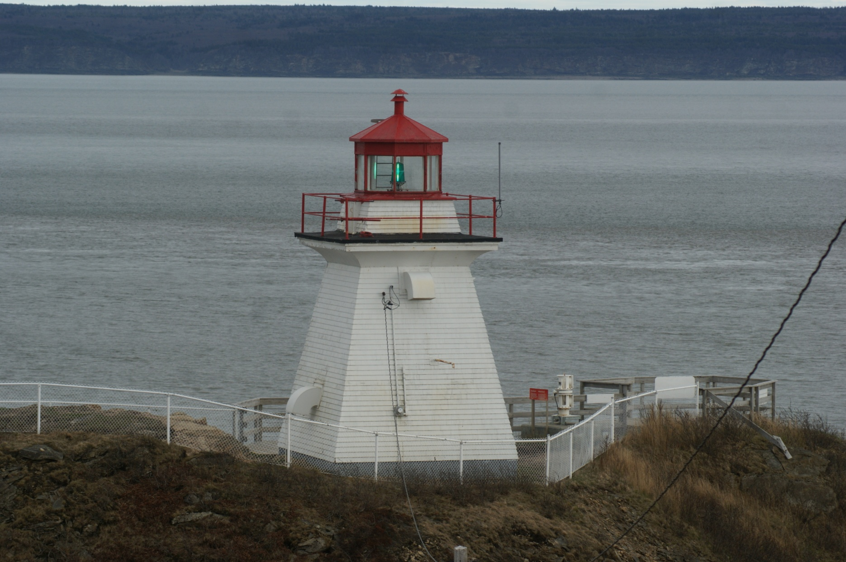
Can-NB-Cape Enrage

Slide 4
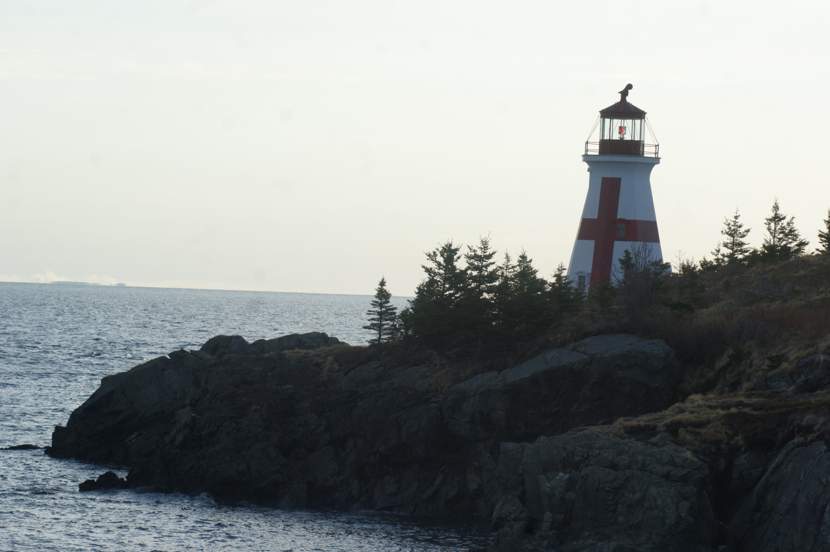
Can-NB-East Quoddy Head Harbour

Slide 5
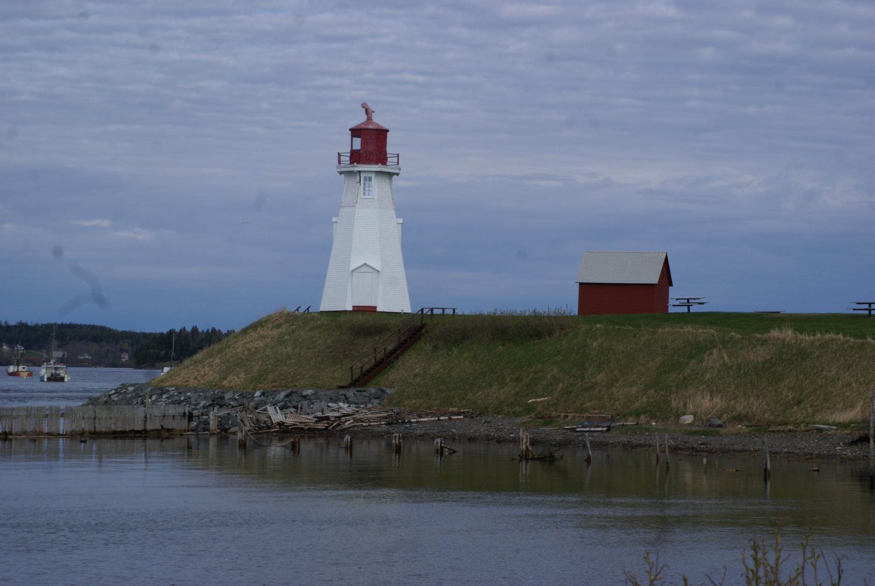
Can-NB-Mulholland Point

Slide 6
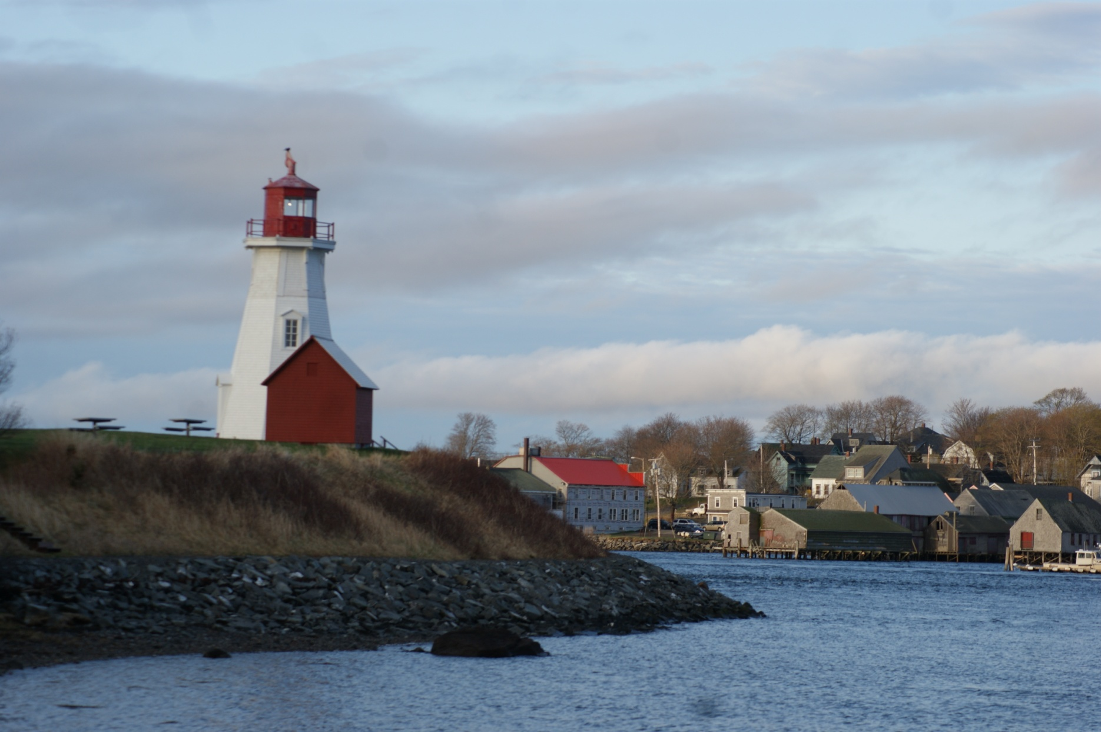
Can-NB-Mulholland Pt

Slide 7
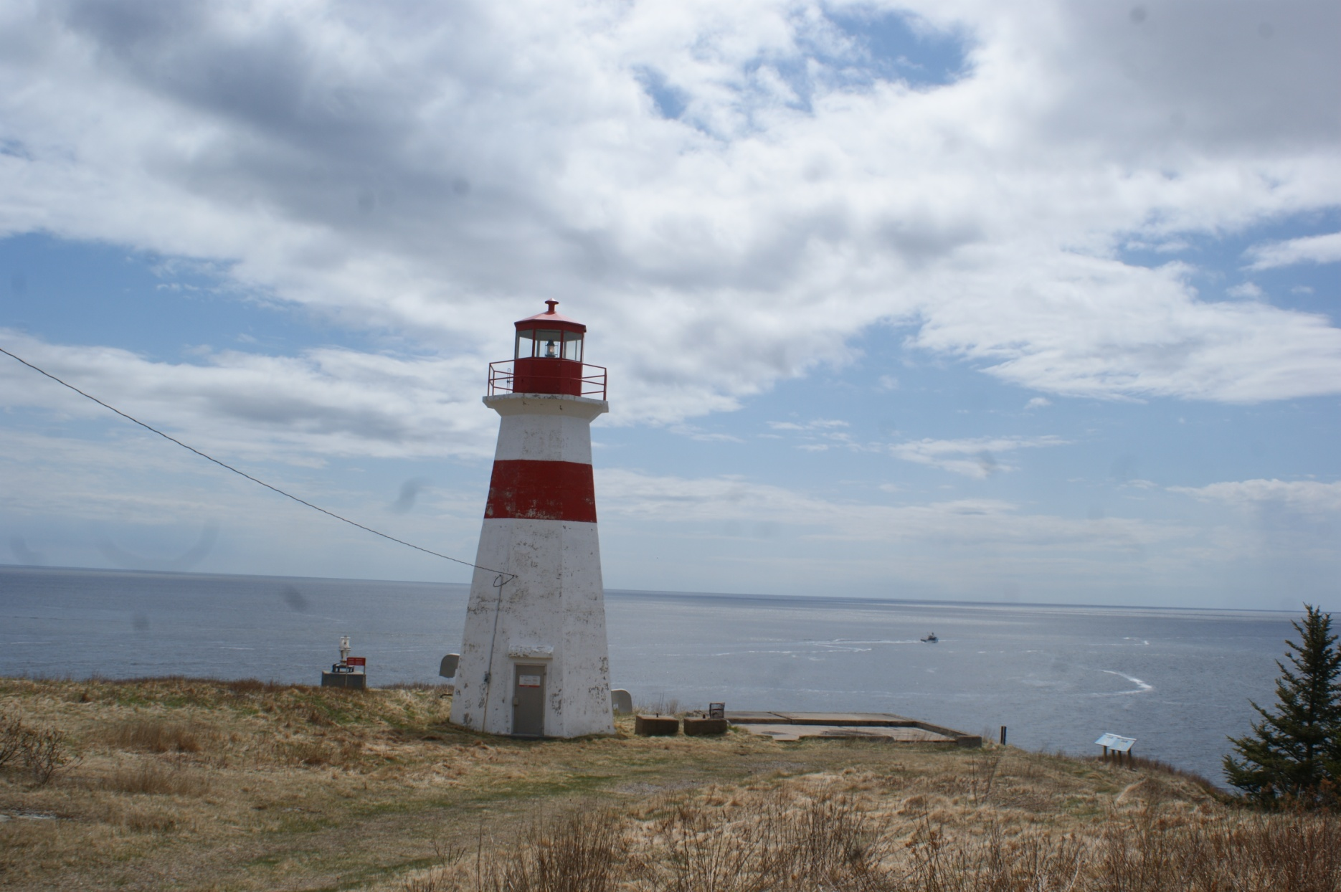
Can-NB-Musquash

Slide 8
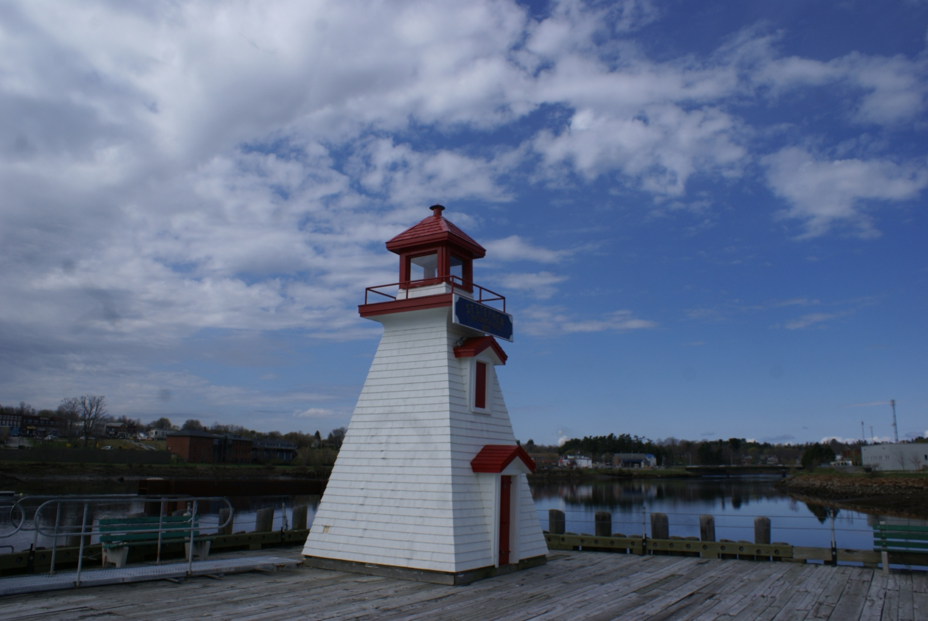
Can-NB-St. Stephen

