Slide 1
Canadian Lighthouses
Newfoundland
Kris E Roberts

Slide 2
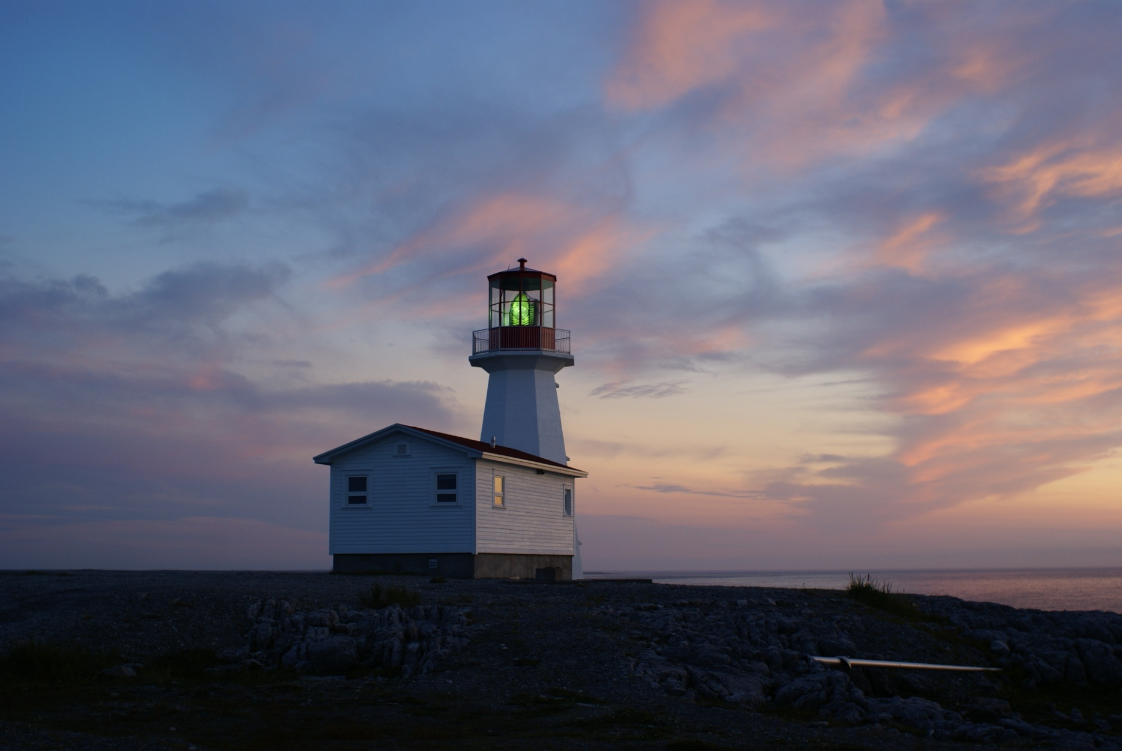
Can-NF-Cape Norman

Slide 3
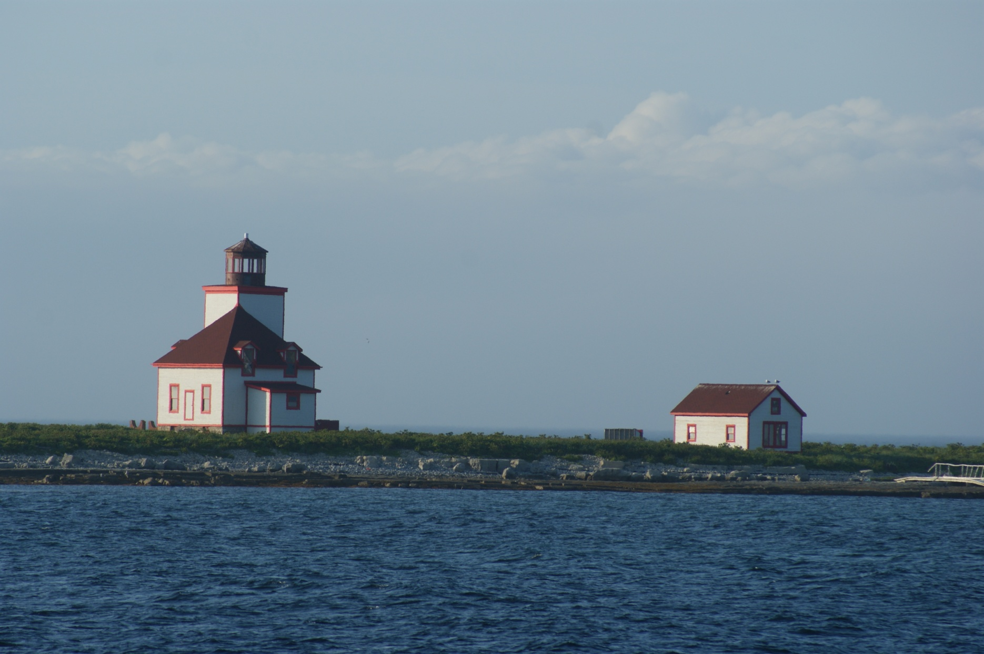
Can-NF-Flowers Cove Island

Slide 4
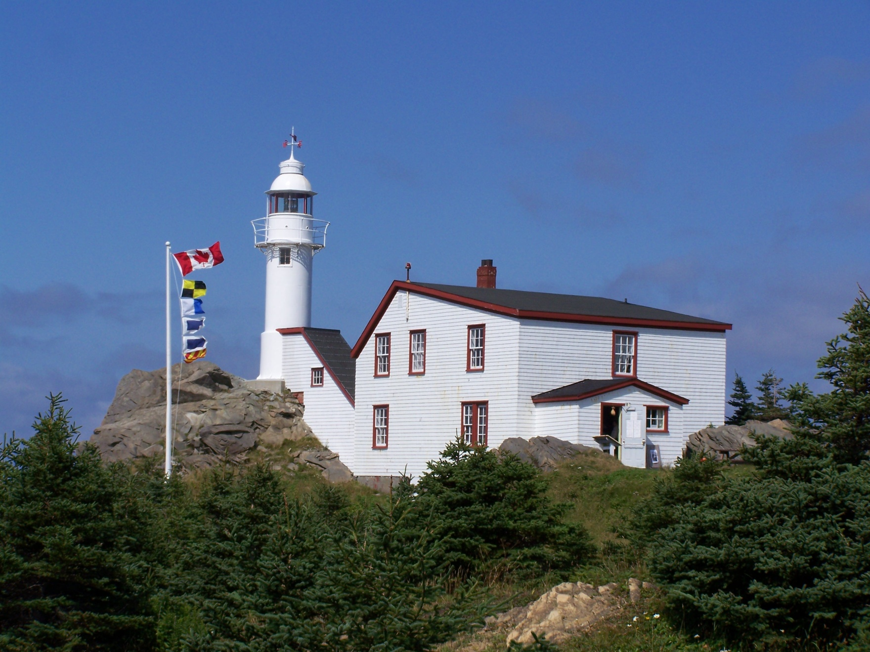
Can-NF-Lobster Cove

Slide 5
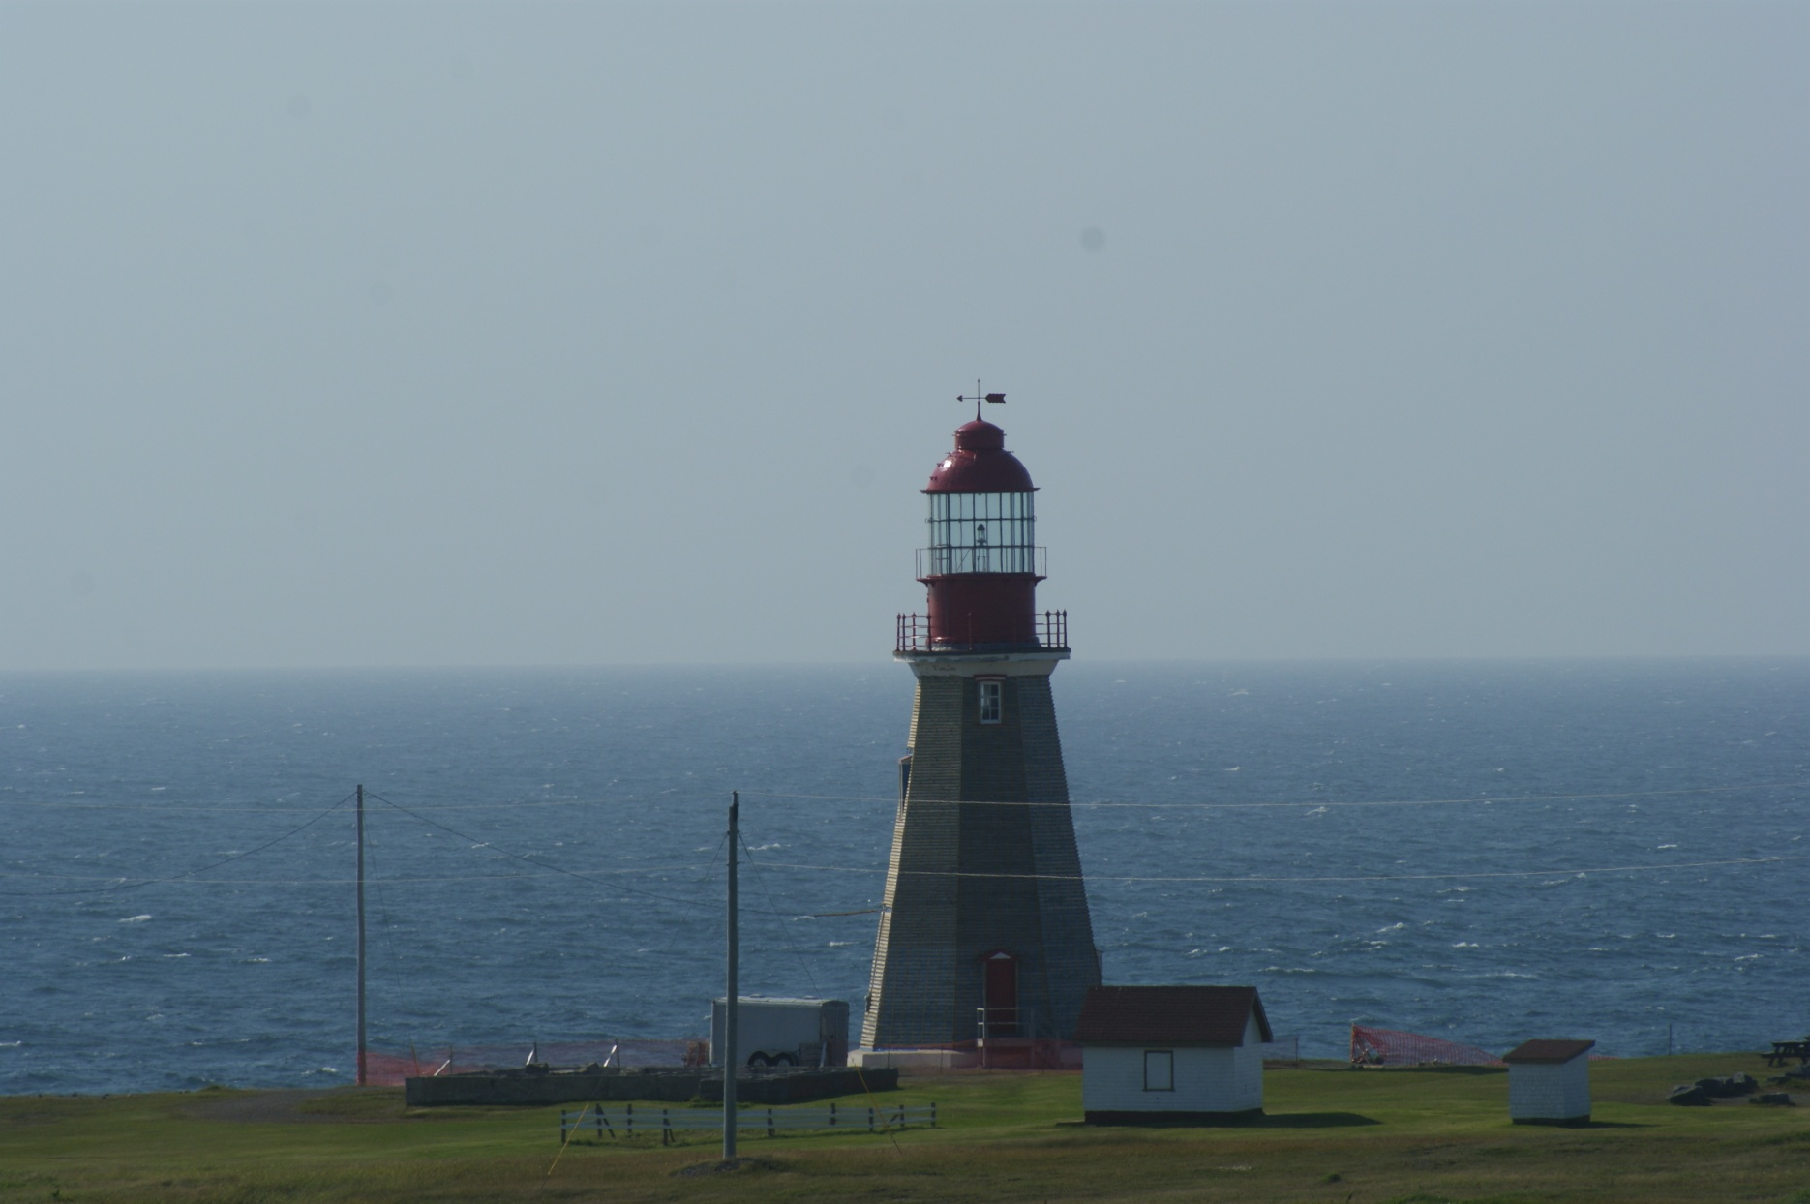
Can-NF-Pointe Riche

Slide 6
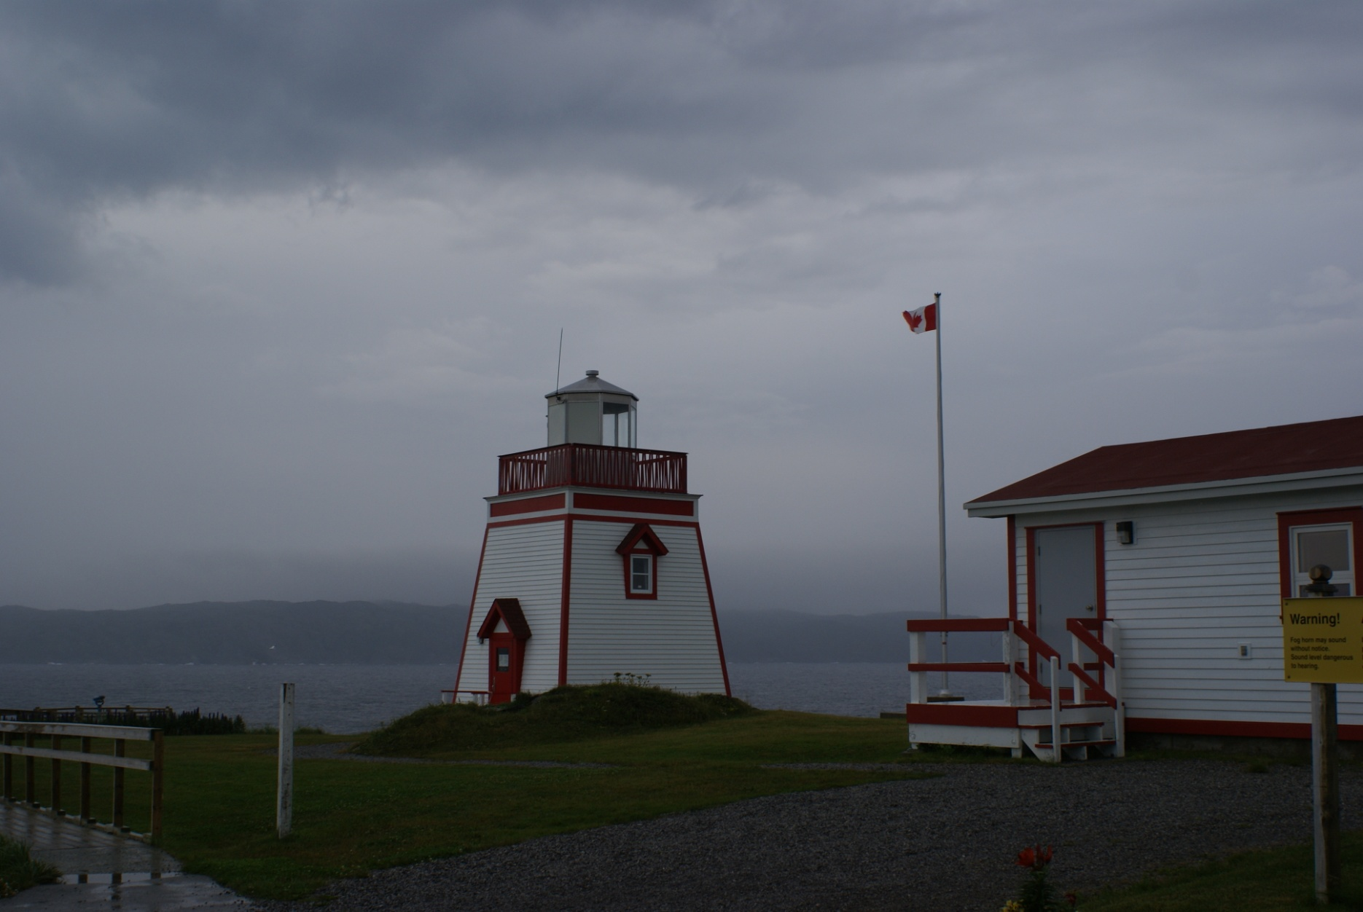
Can-NF-Admiral’s Point

