Slide 1
Canadian Lighthouses
Nova Scotia
Kris E Roberts

Slide 2
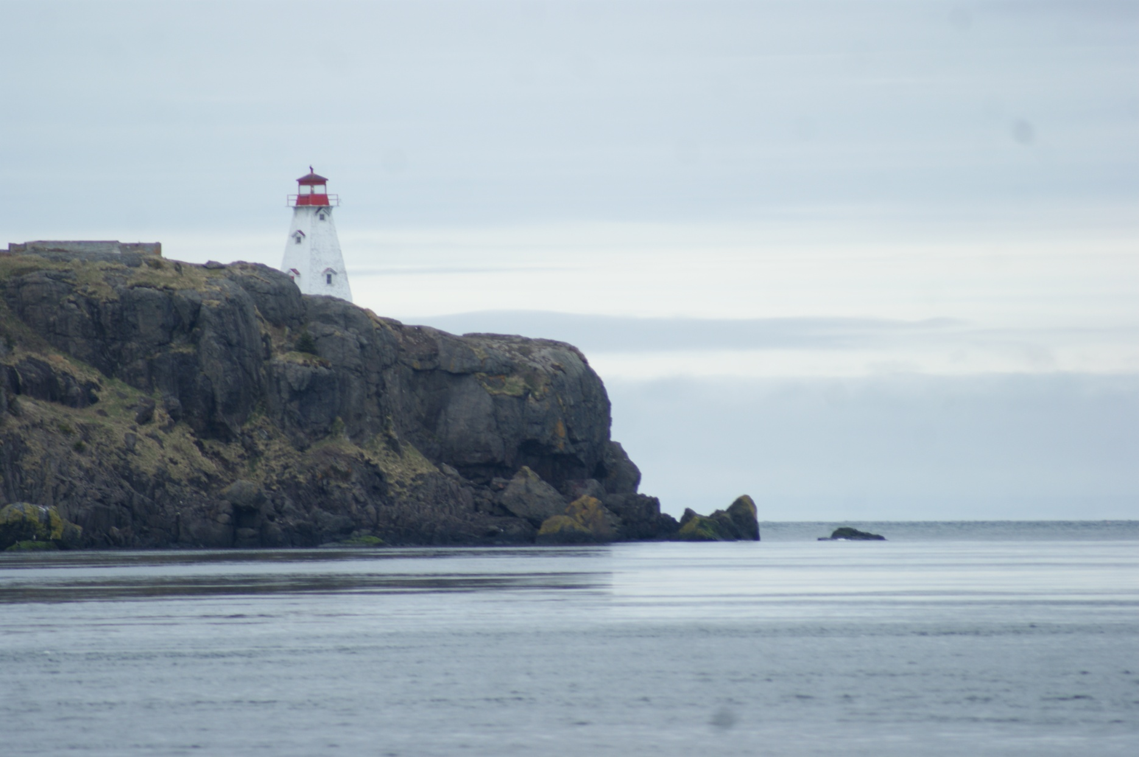
Can-NS-Boar's Head (Tiverton)

Slide 3
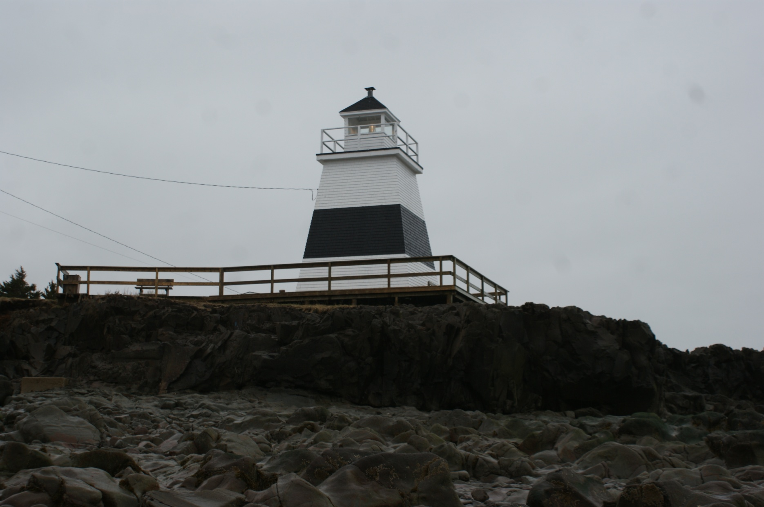
Can-NS-Margaretsville

Slide 4
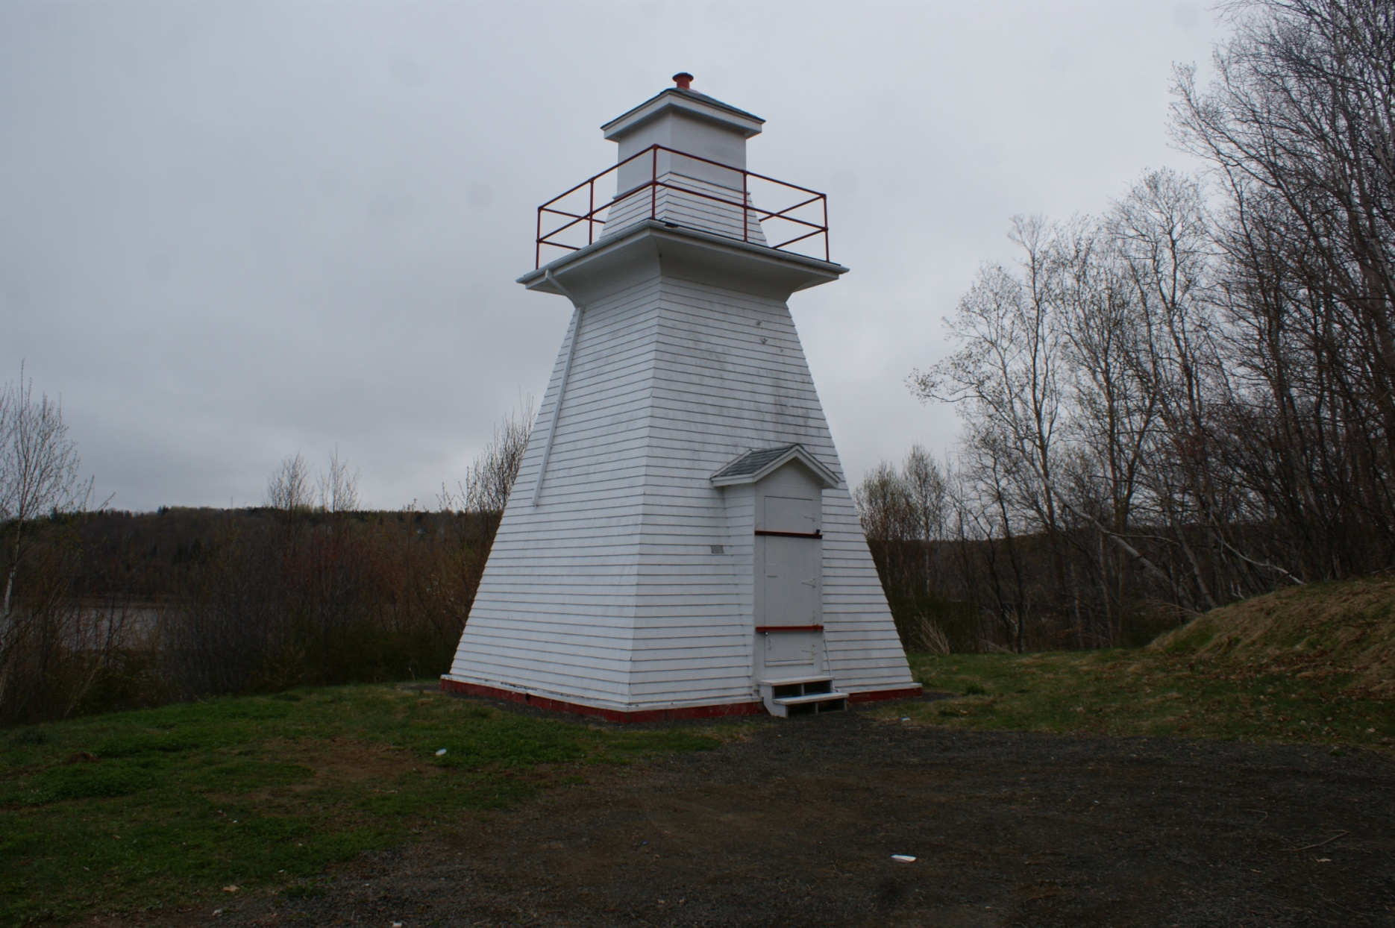
Can-NS-Annapolis

Slide 5
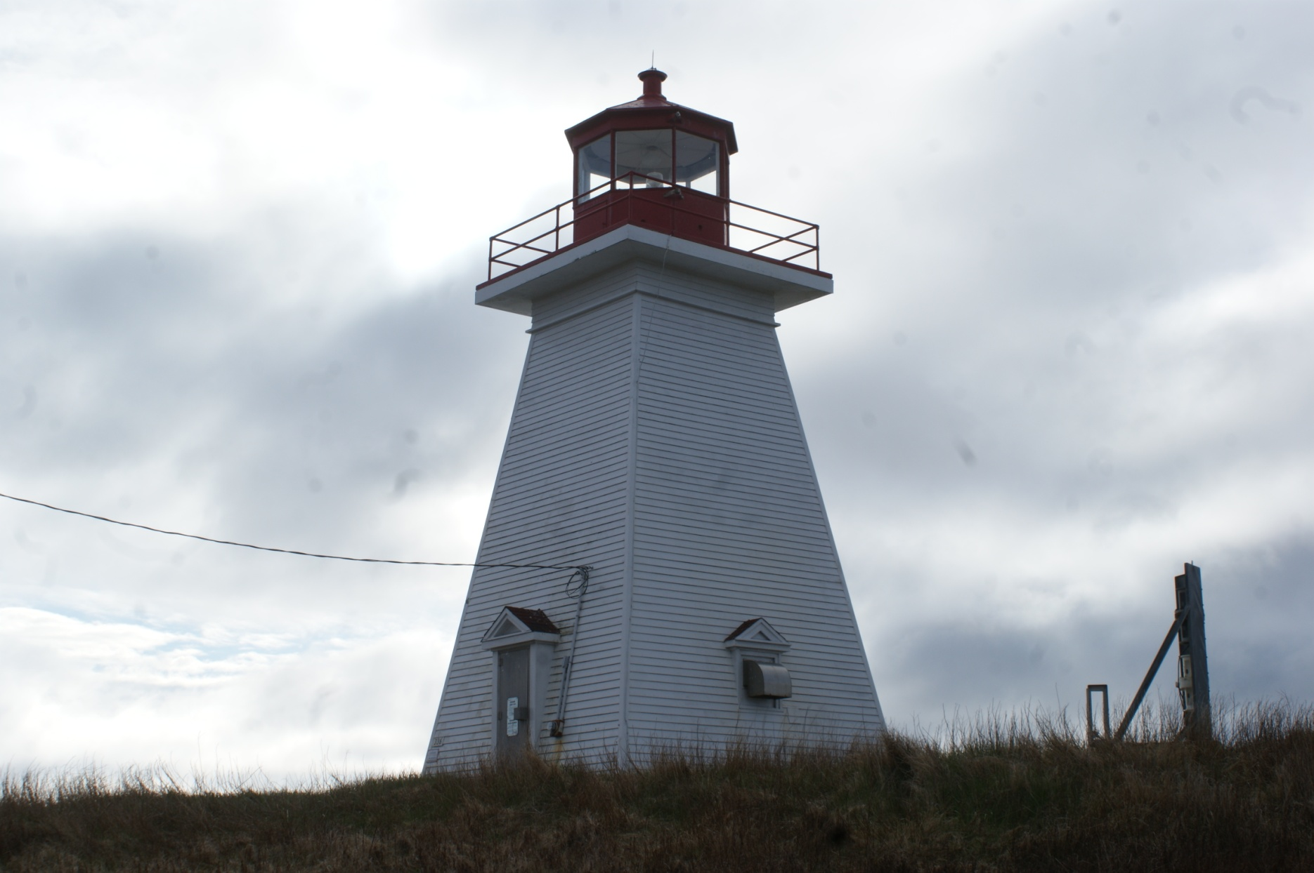
Can-NS-Baccaro Point

Slide 6
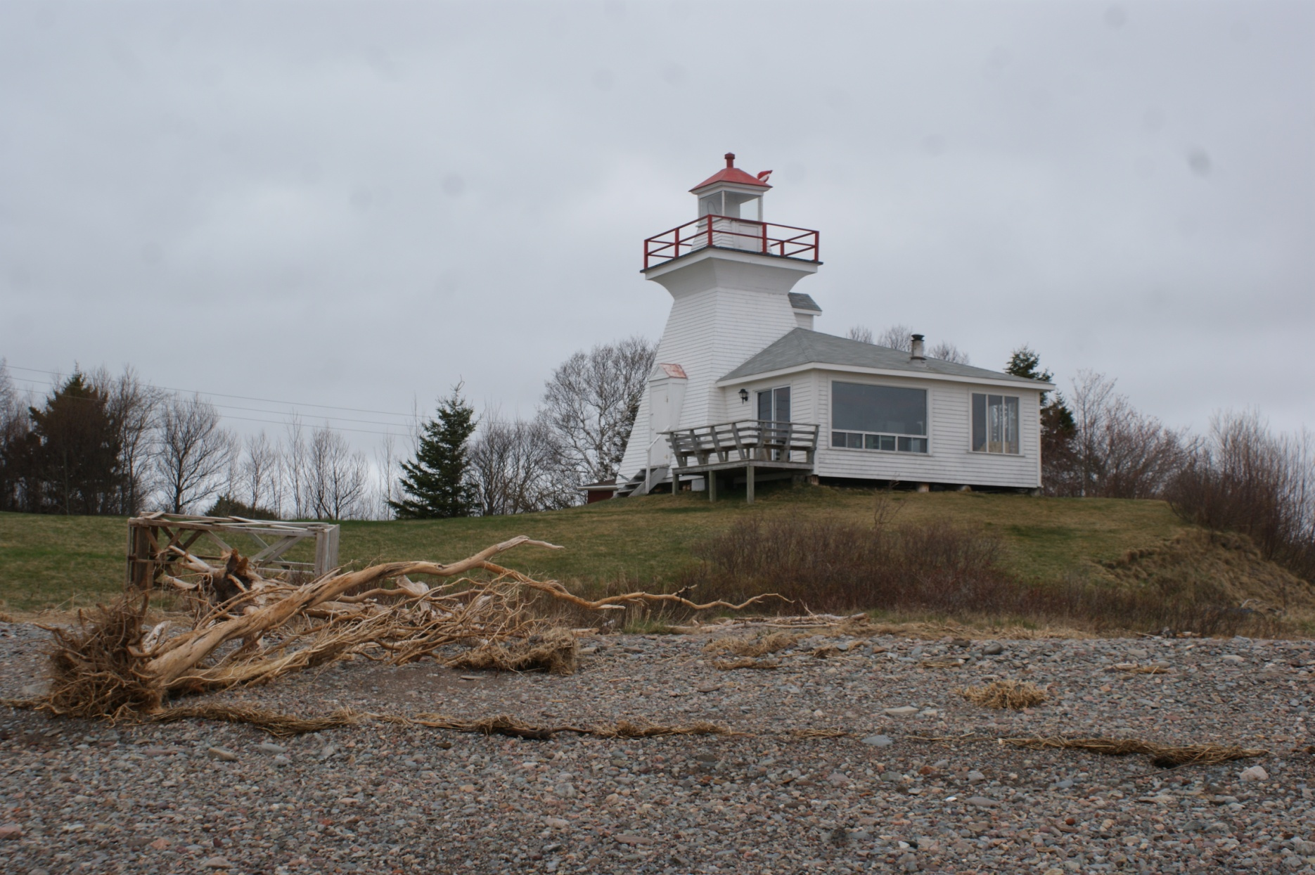
Can-NS-Bass River

Slide 7
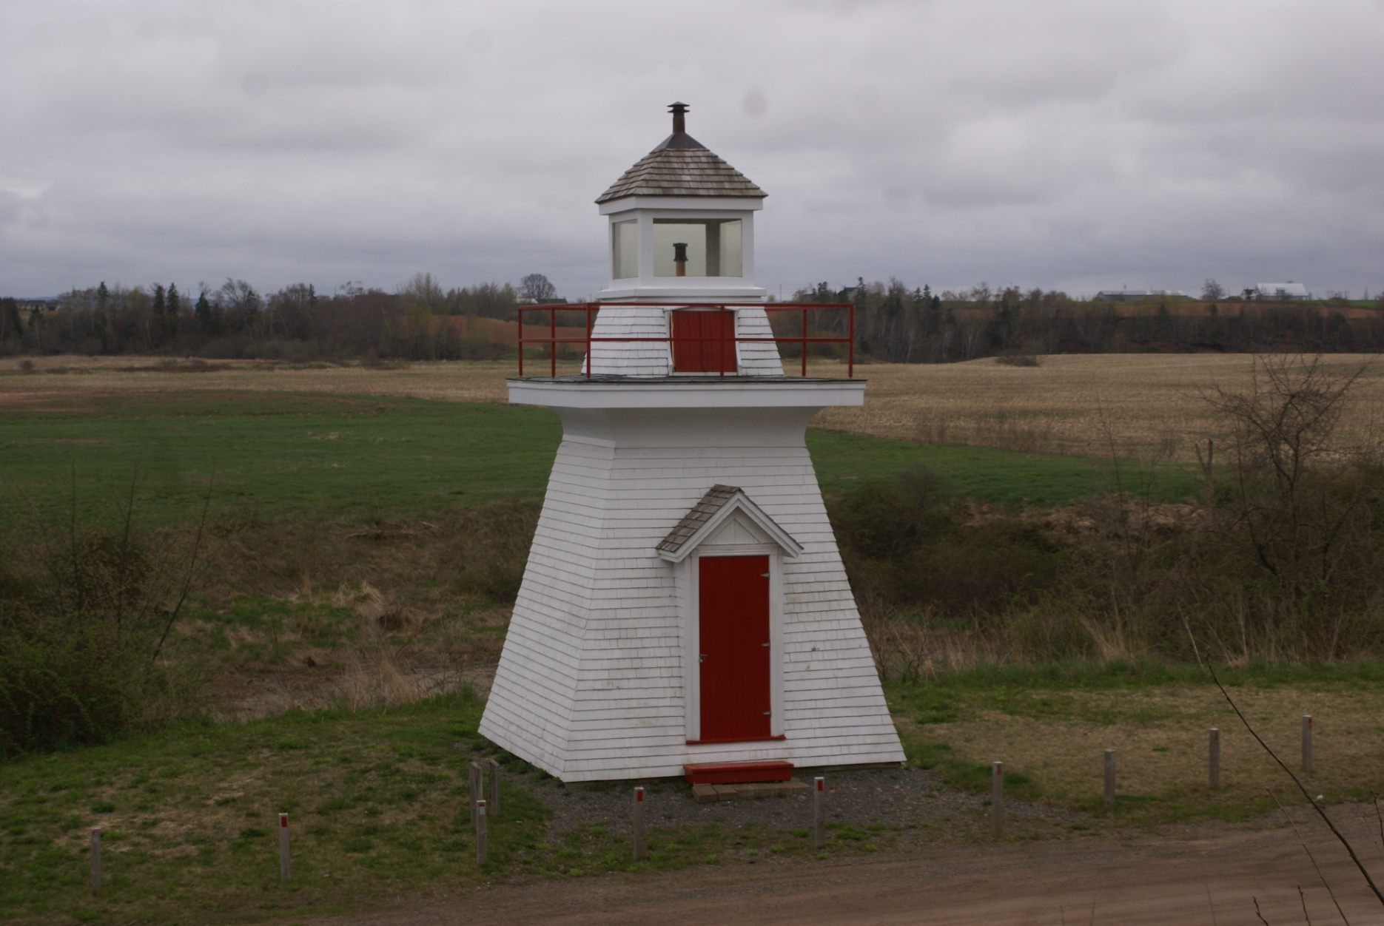
Can-NS-Bear River

Slide 8
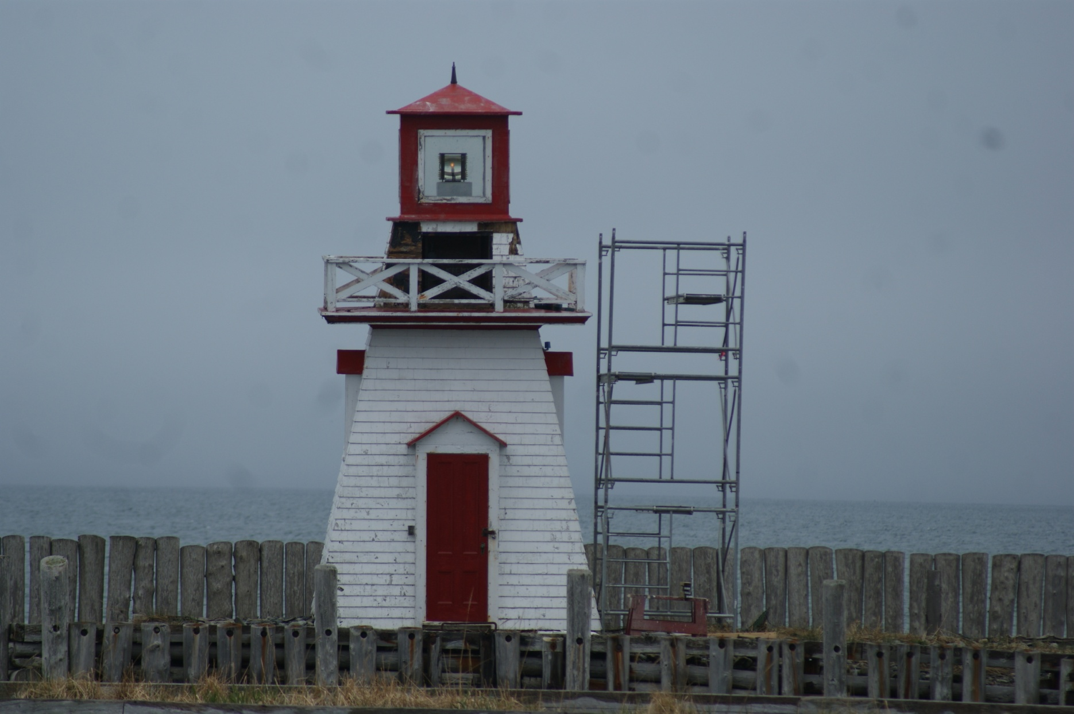
Can-NS-Belliveau Cove

Slide 9
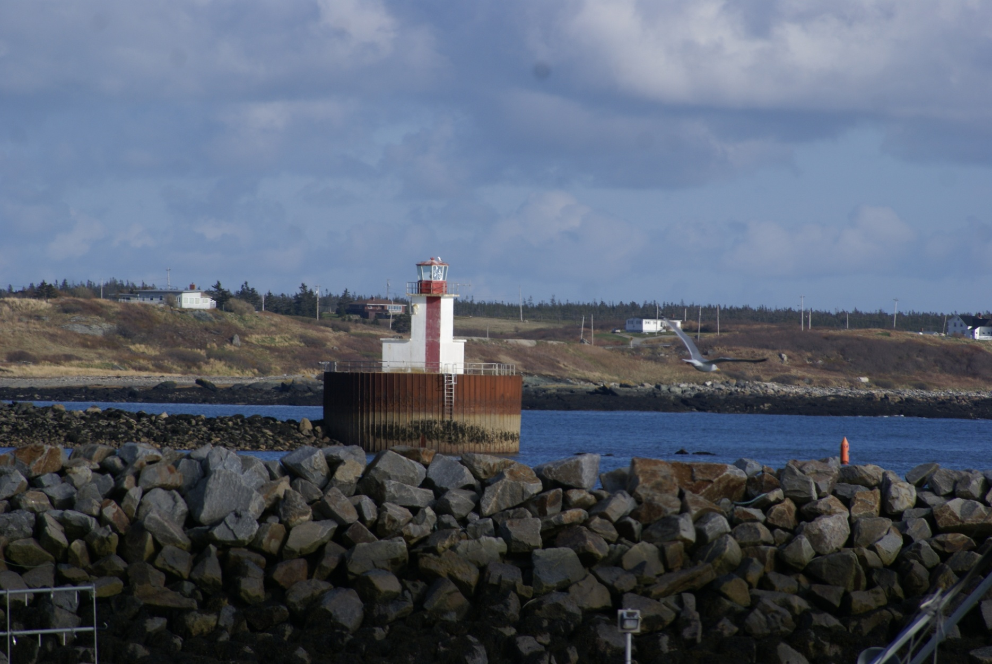
Can-NS-Bunker Island

Slide 10
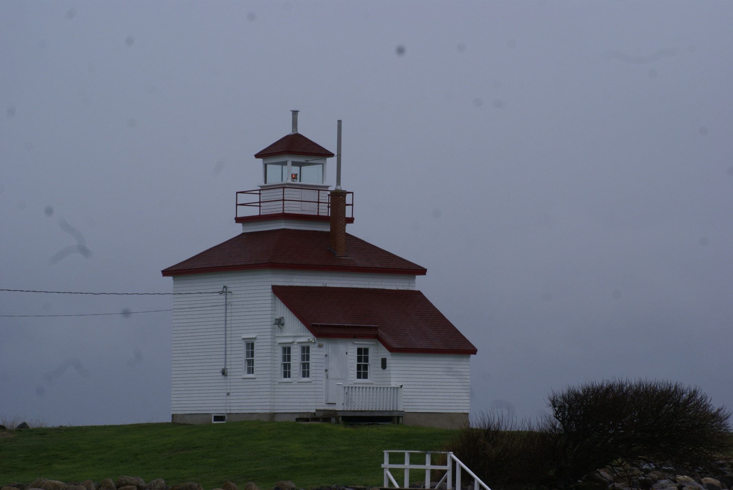
Can-NS-Burntcoat Head

Slide 11
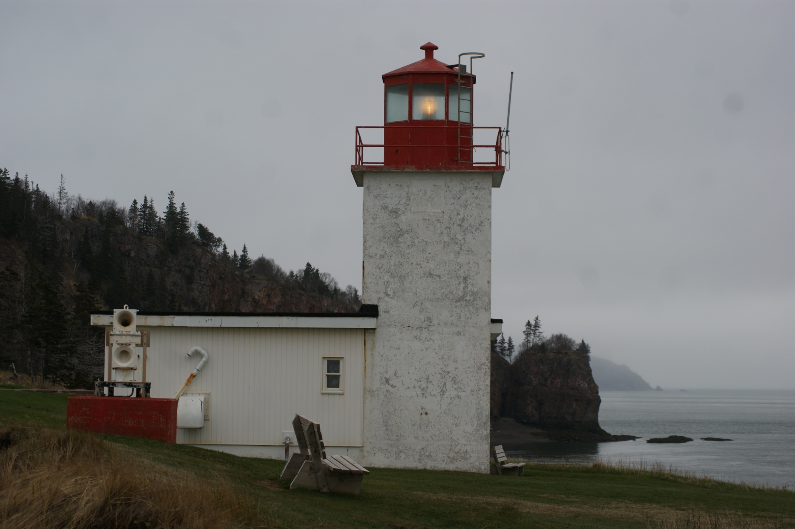
Can-NS-Cape D'Or Light

Slide 12
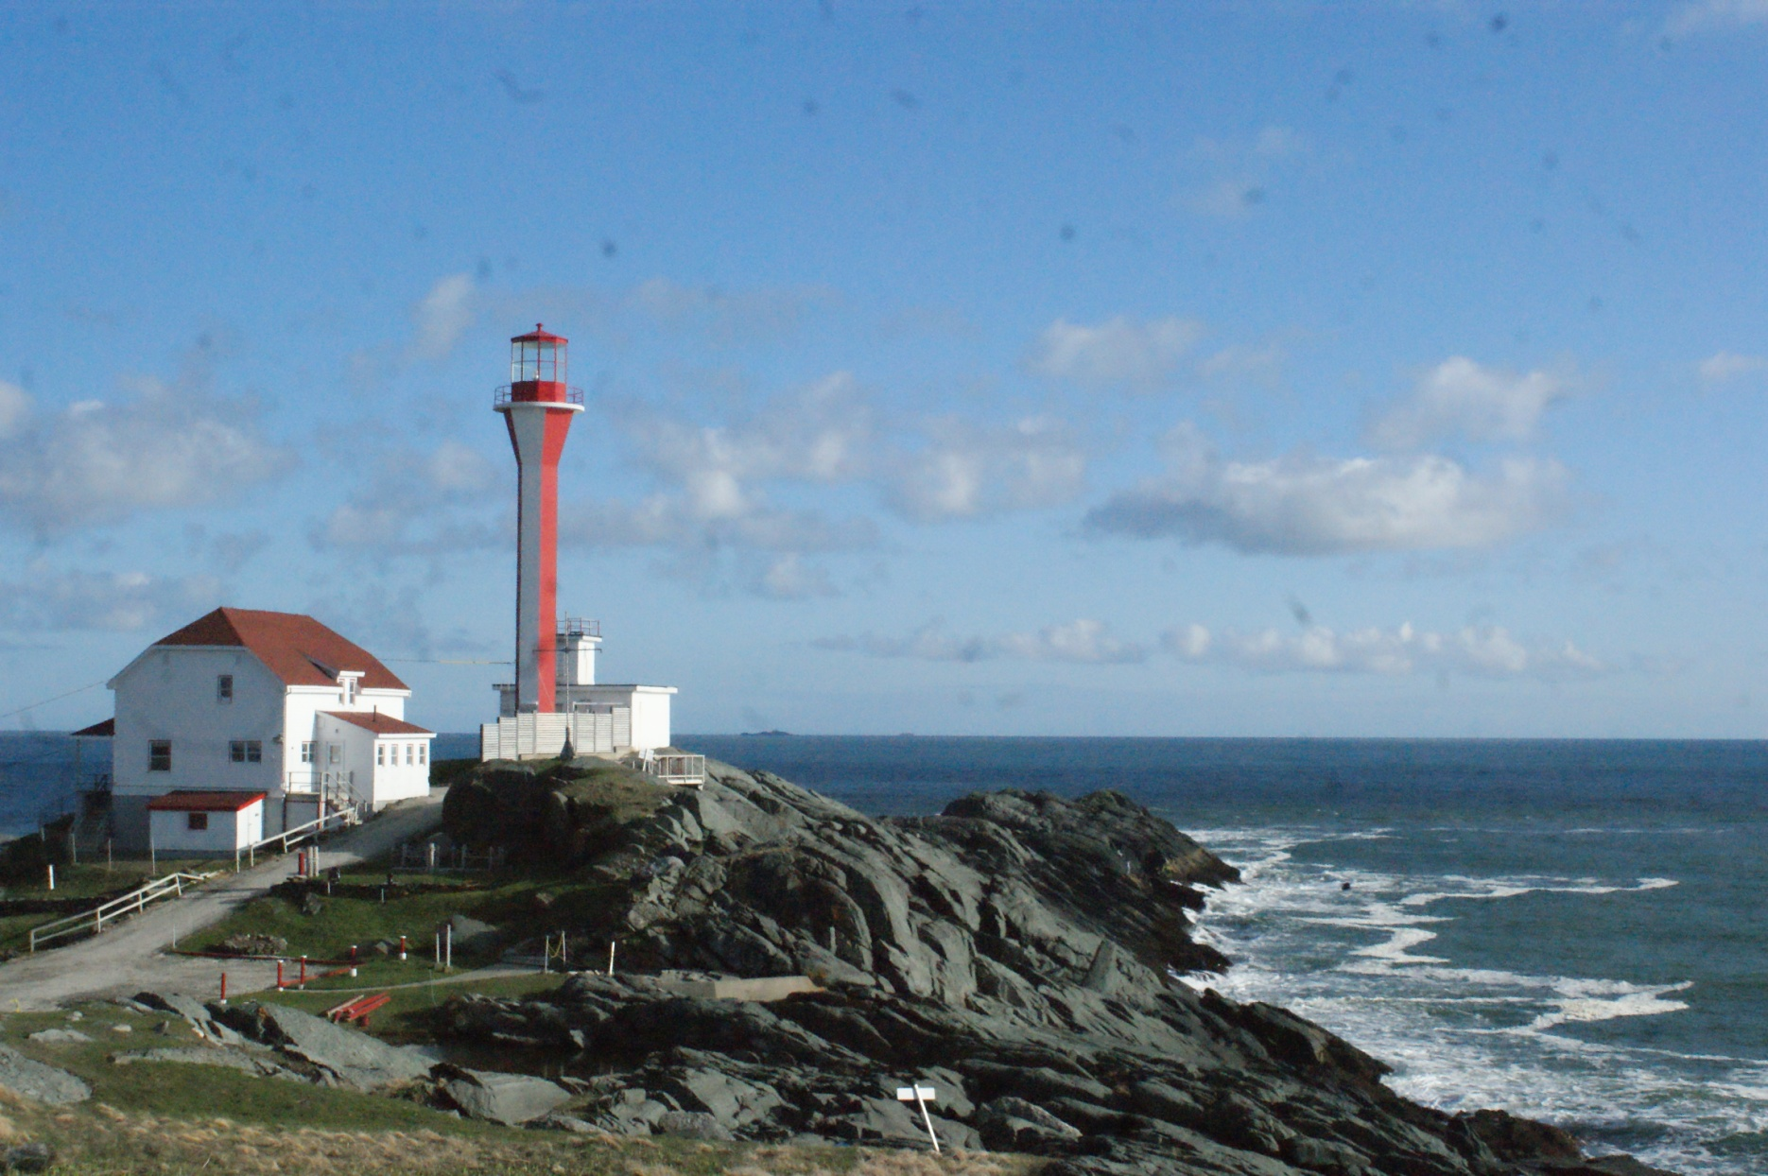
Can-NS-Cape Forchu

Slide 13
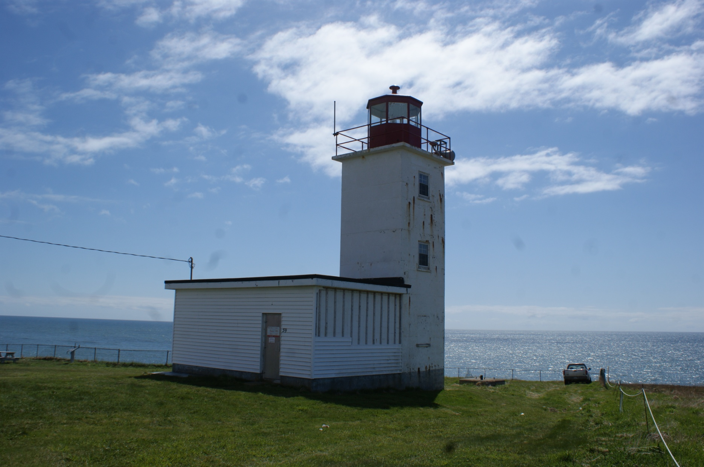
Can-NS-Cape St. Mary Lightstation

Slide 14
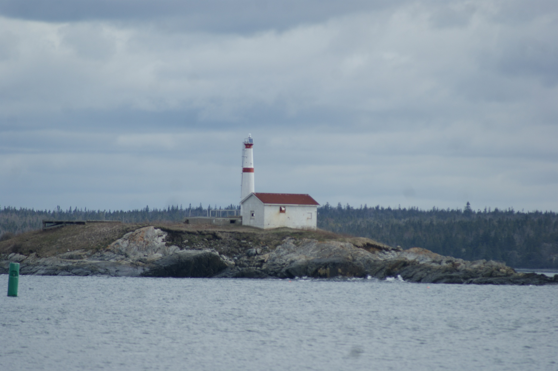
Can-NS-Carter Island

Slide 15
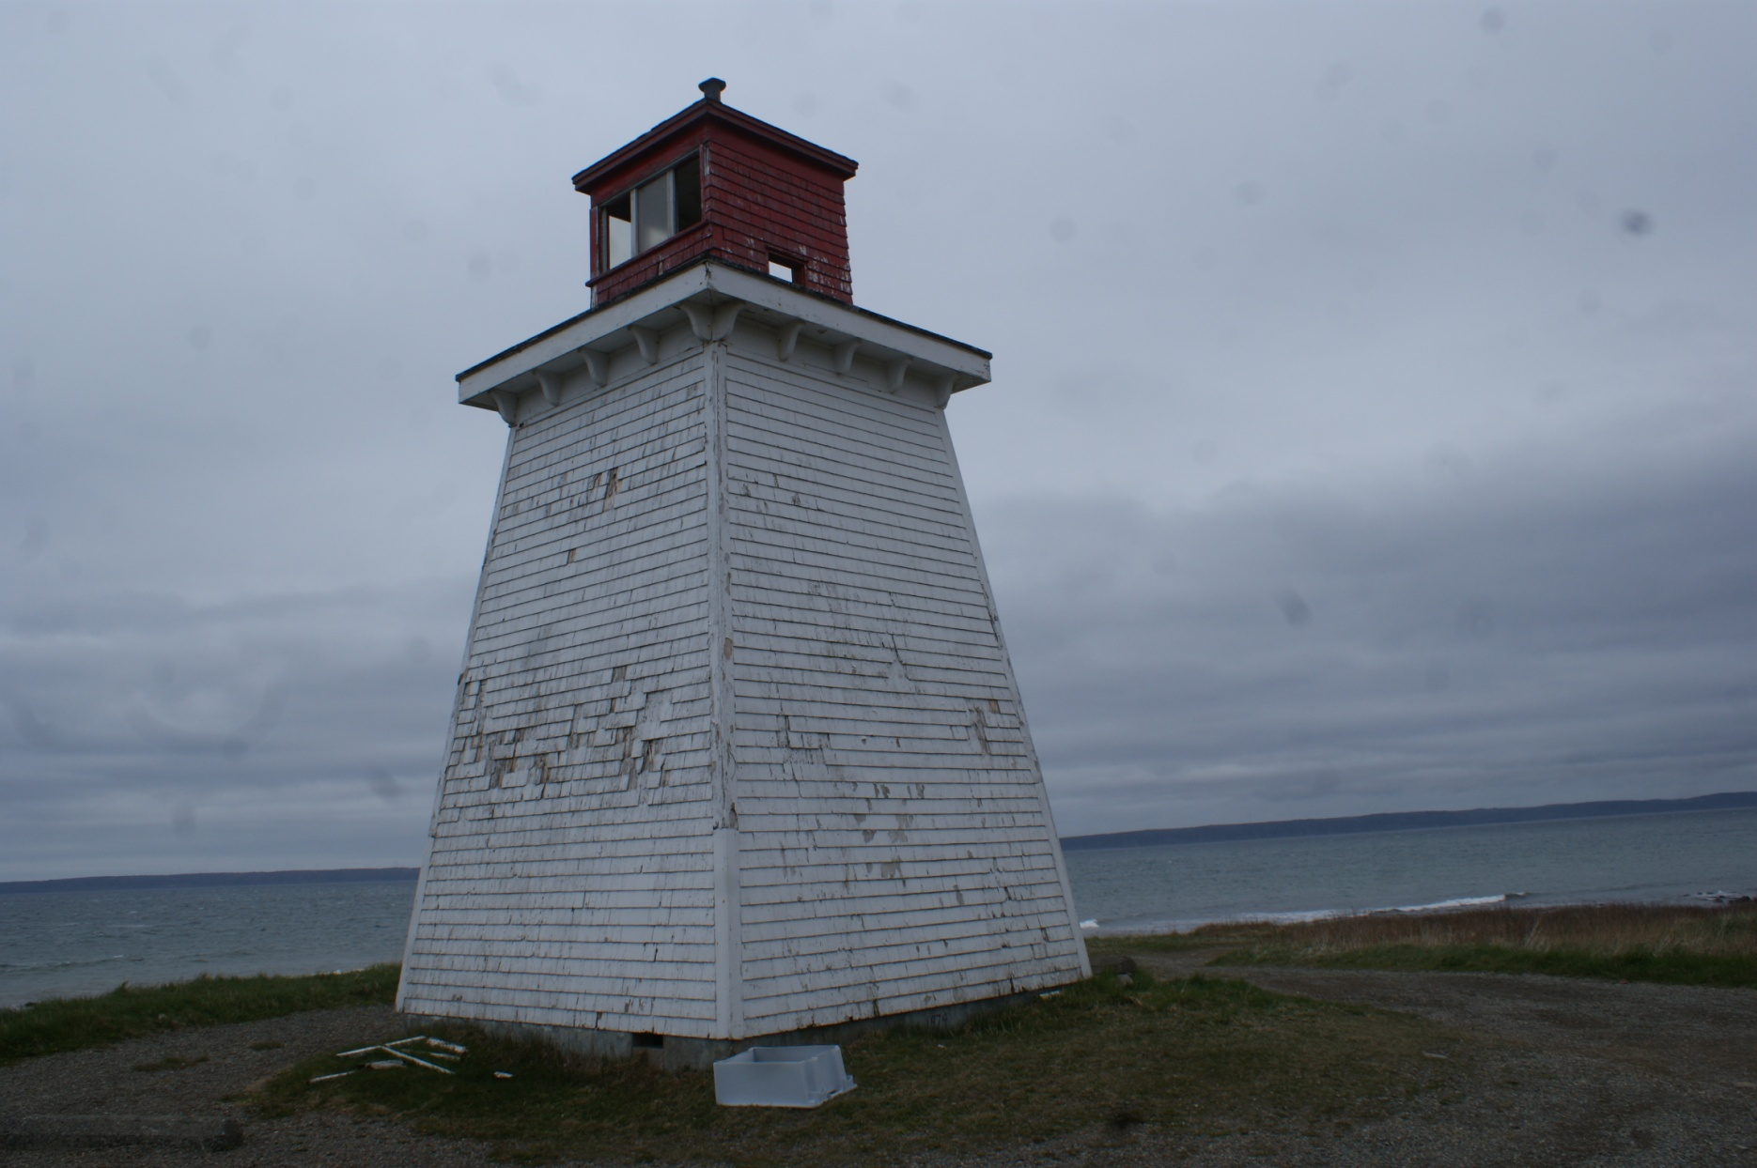
Can-NS-Church Point

Slide 16
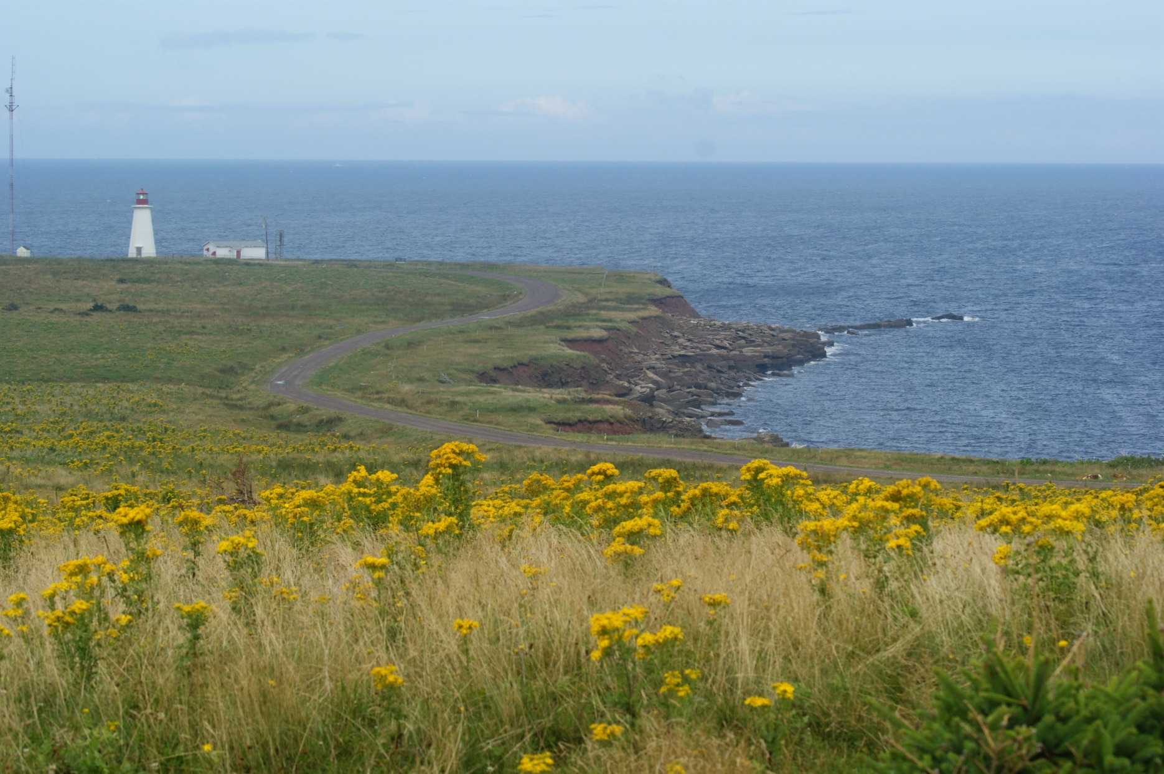
Can-NS-Enragee Point

Slide 17
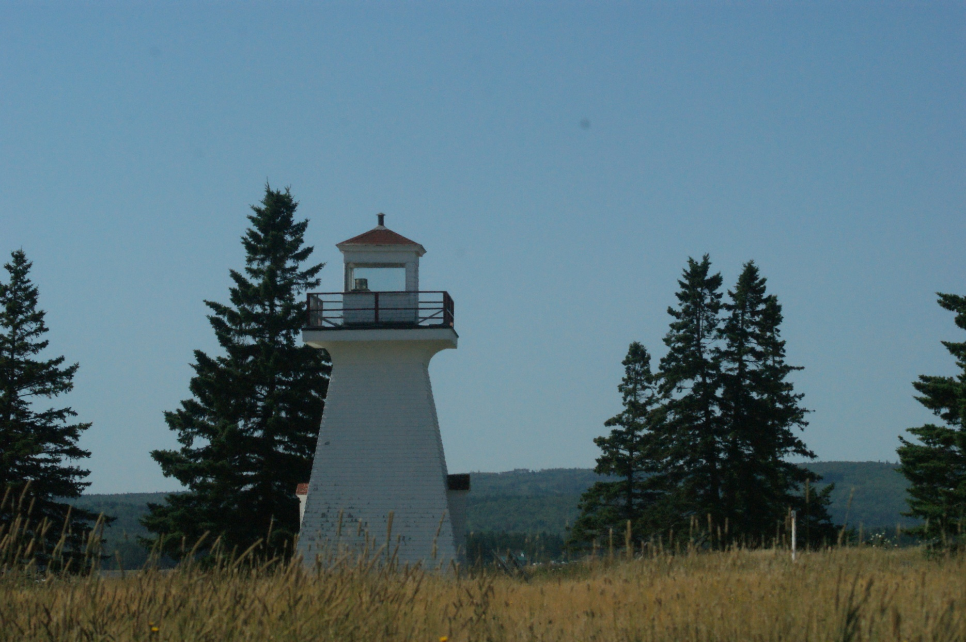
Can-NS-Five Island

Slide 18
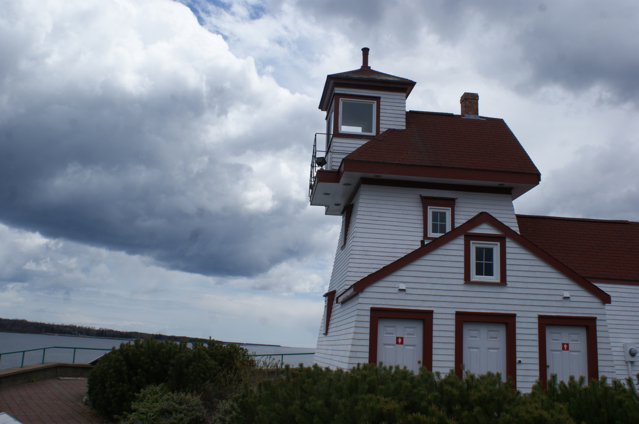
Can-NS-Fort Point

Slide 19
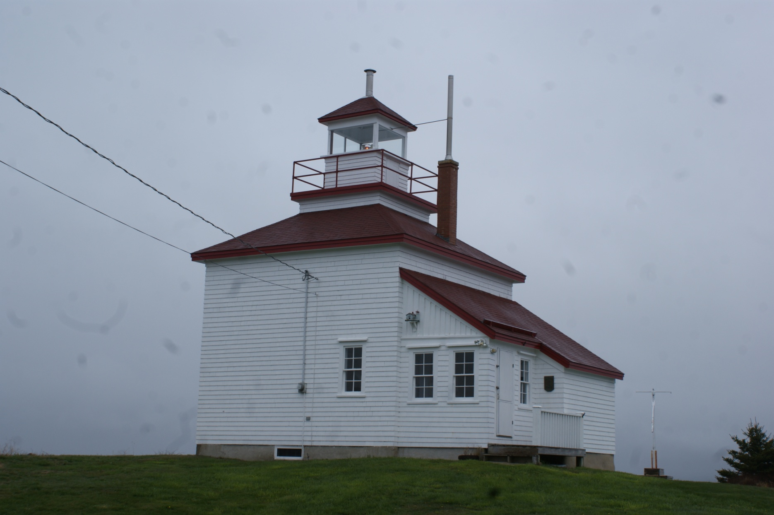
Can-NS-Gilbert's Cove

Slide 20
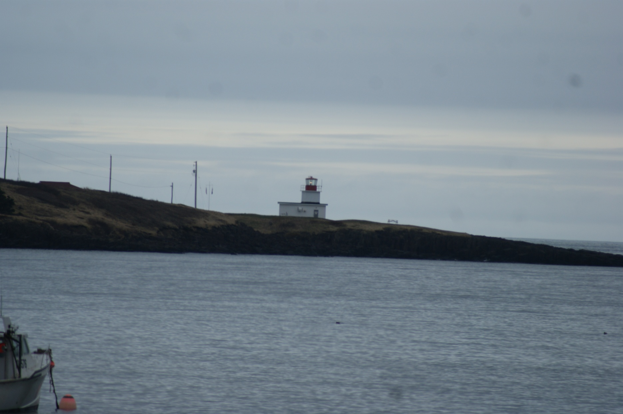
Can-NS-Grand Passage

Slide 21
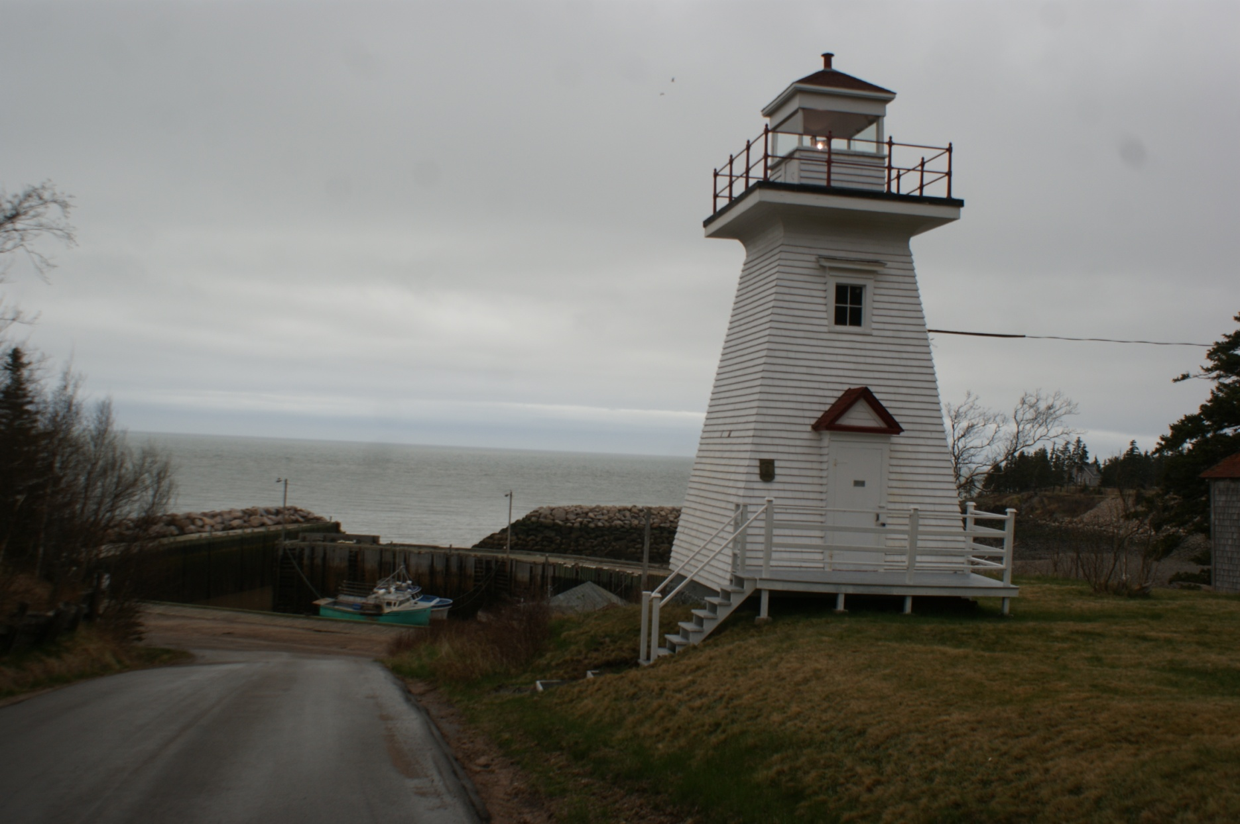
Can-NS-Hampton

Slide 22
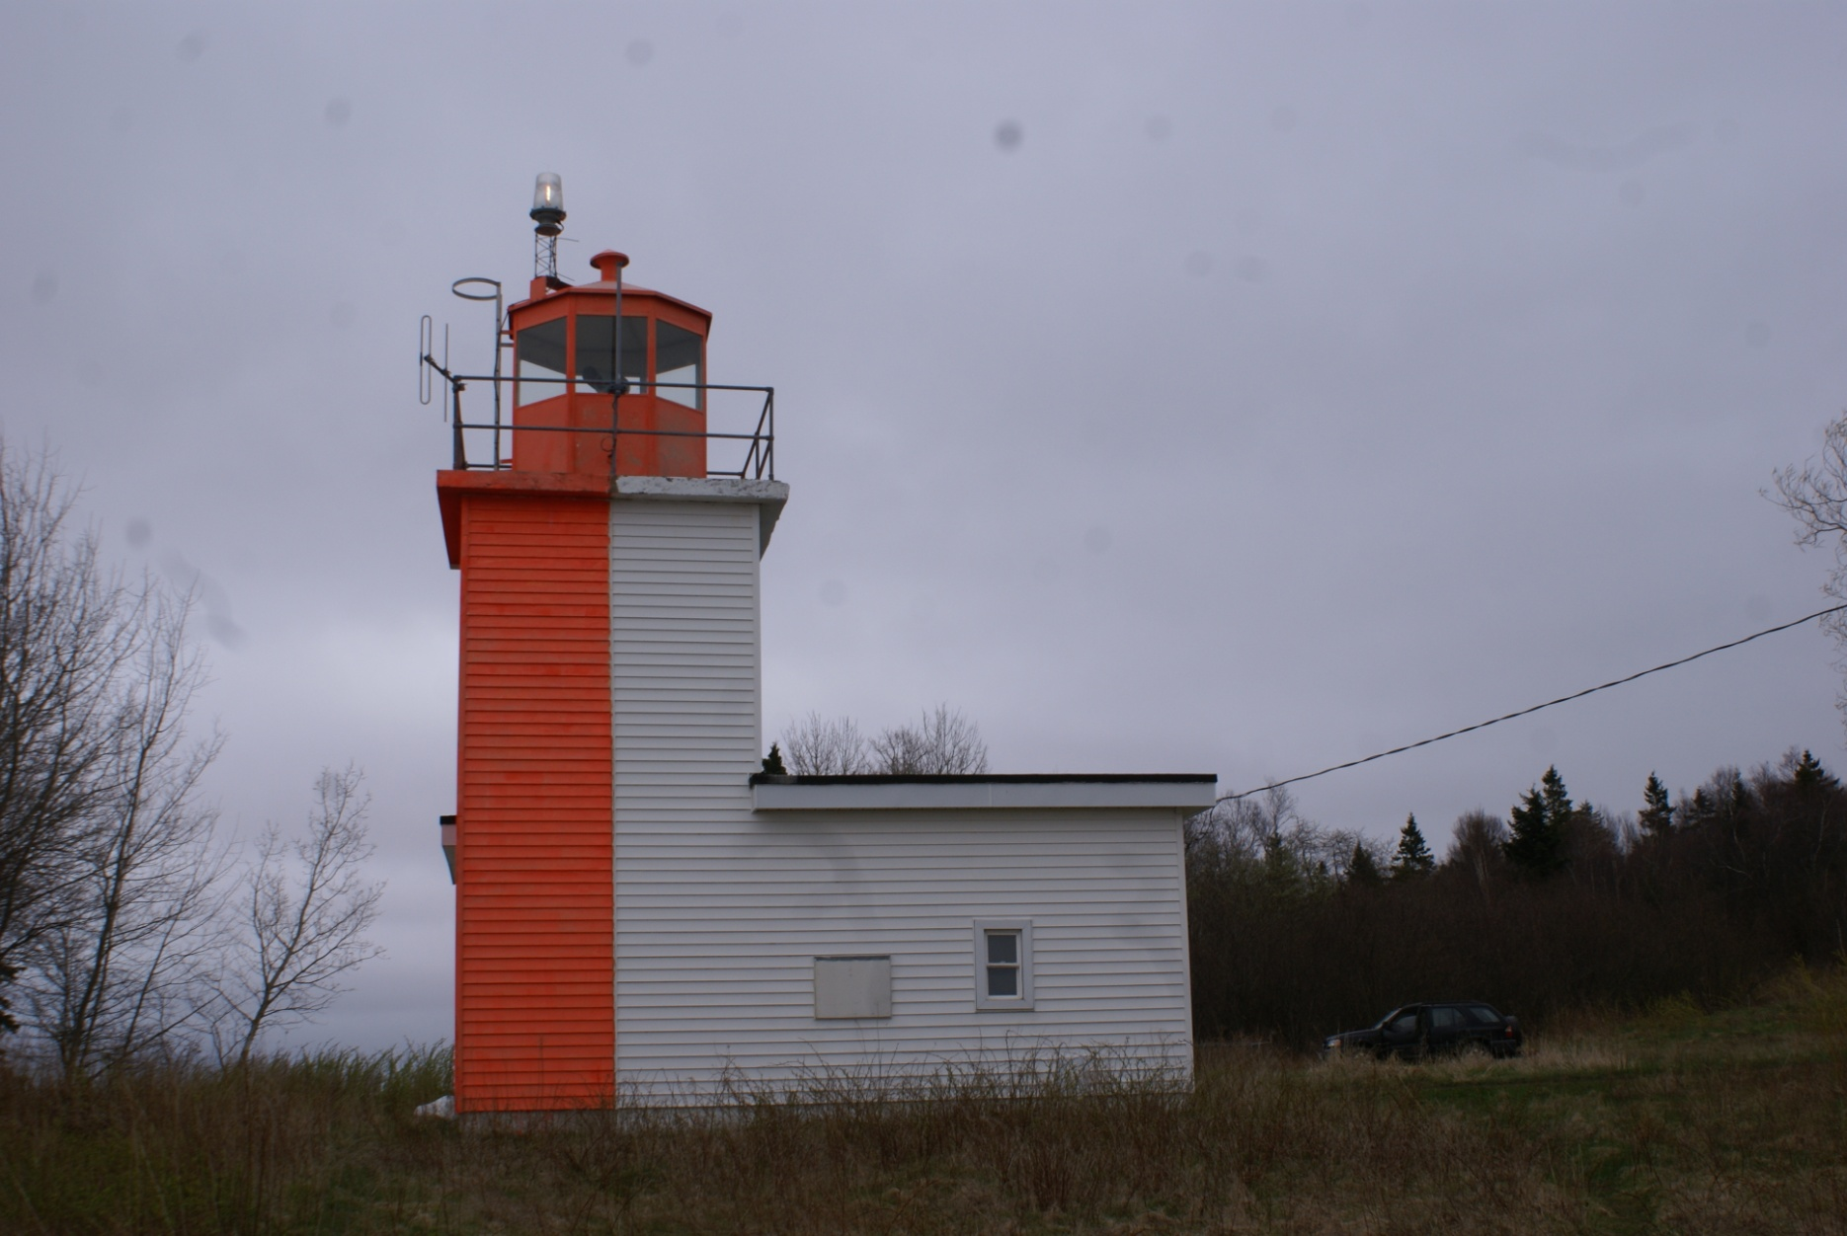
Can-NS-Horton Bluff Range Front

Slide 23
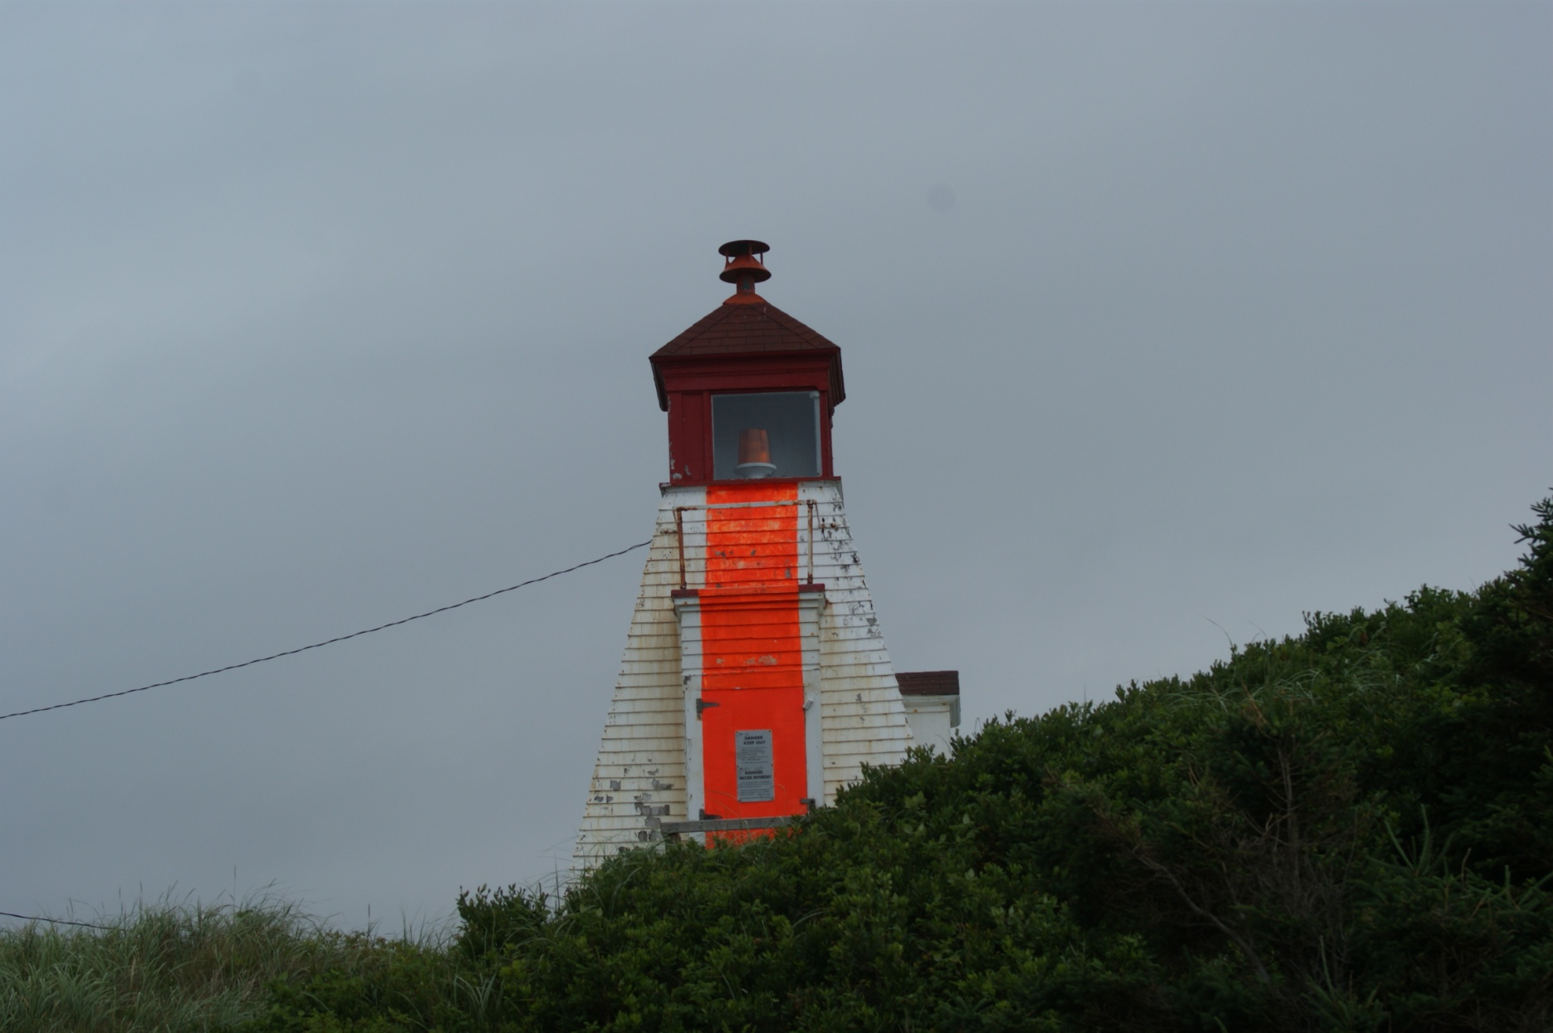
Can-NS-Margaree Harbour Range Front

Slide 24
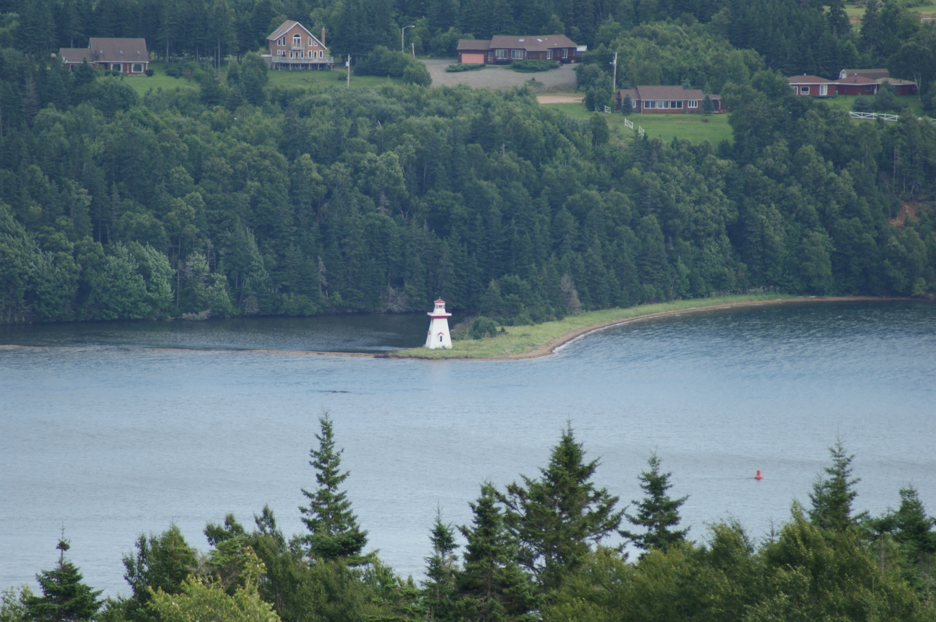
Can-NS-McNeil Beach

Slide 25
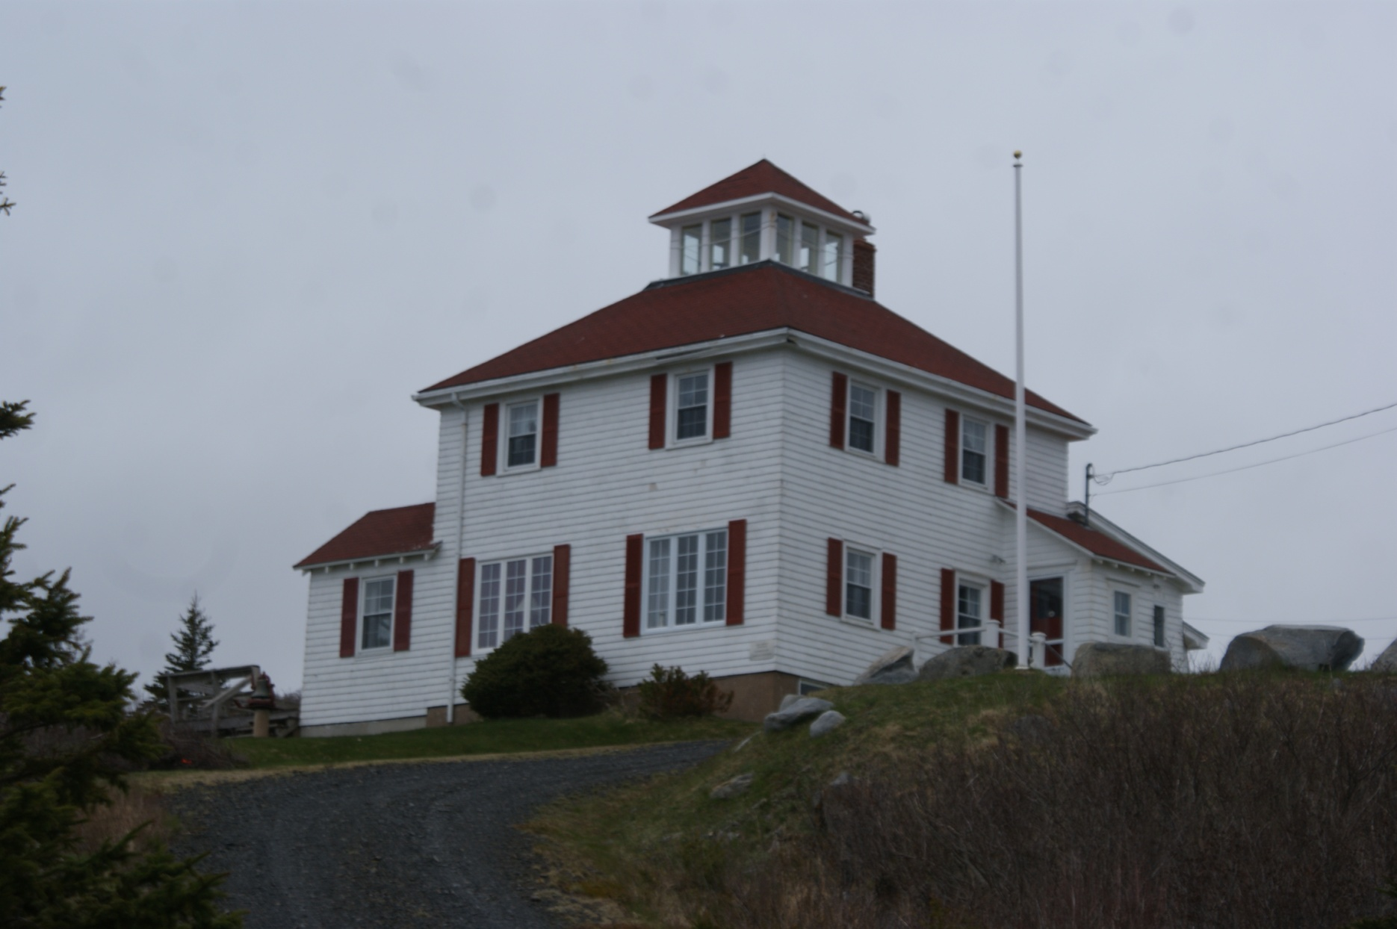
Can-NS-Medway Head Old

Slide 26
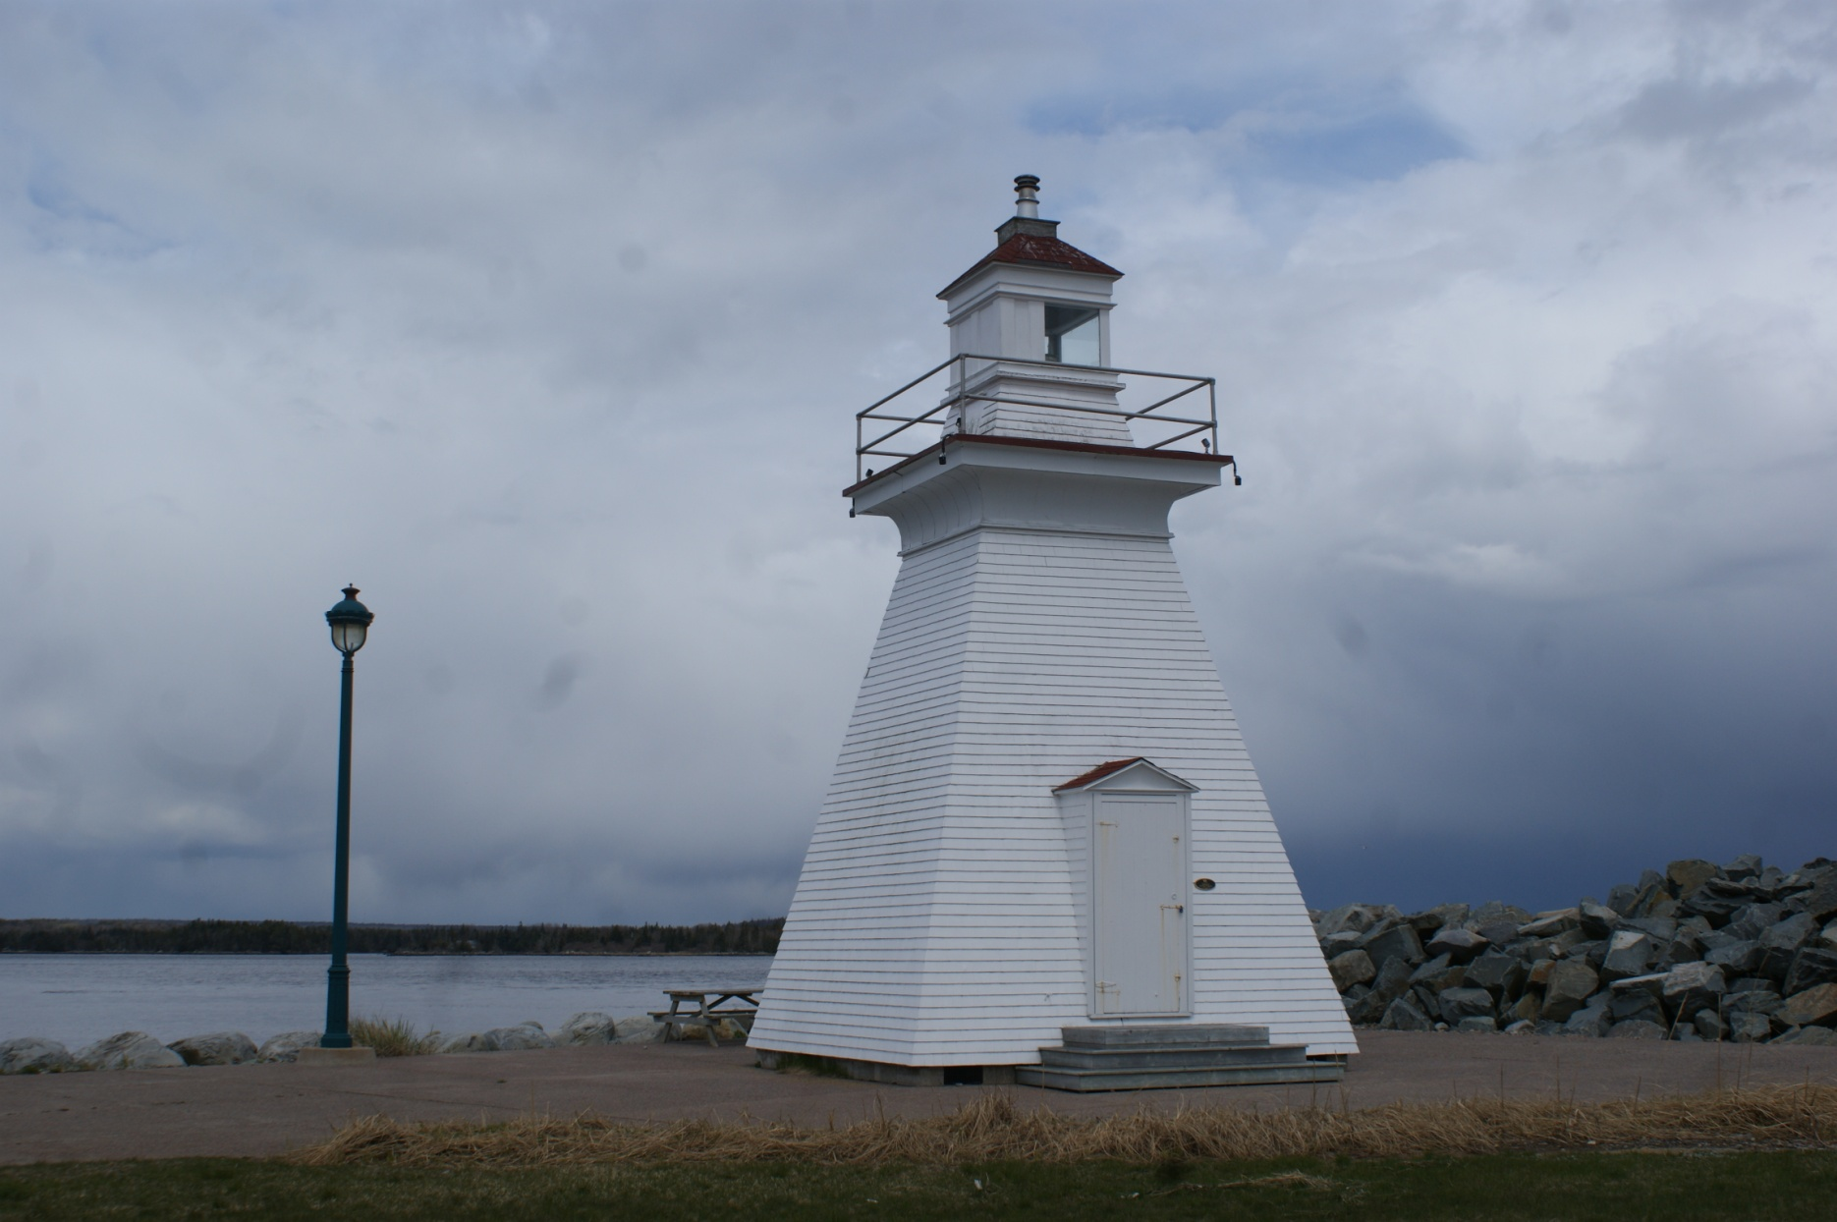
Can-NS-Medway Head

Slide 27
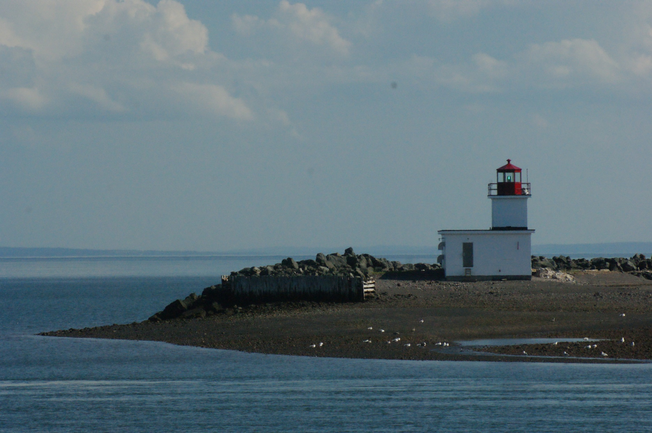
Can-NS-Parrsboro

Slide 28
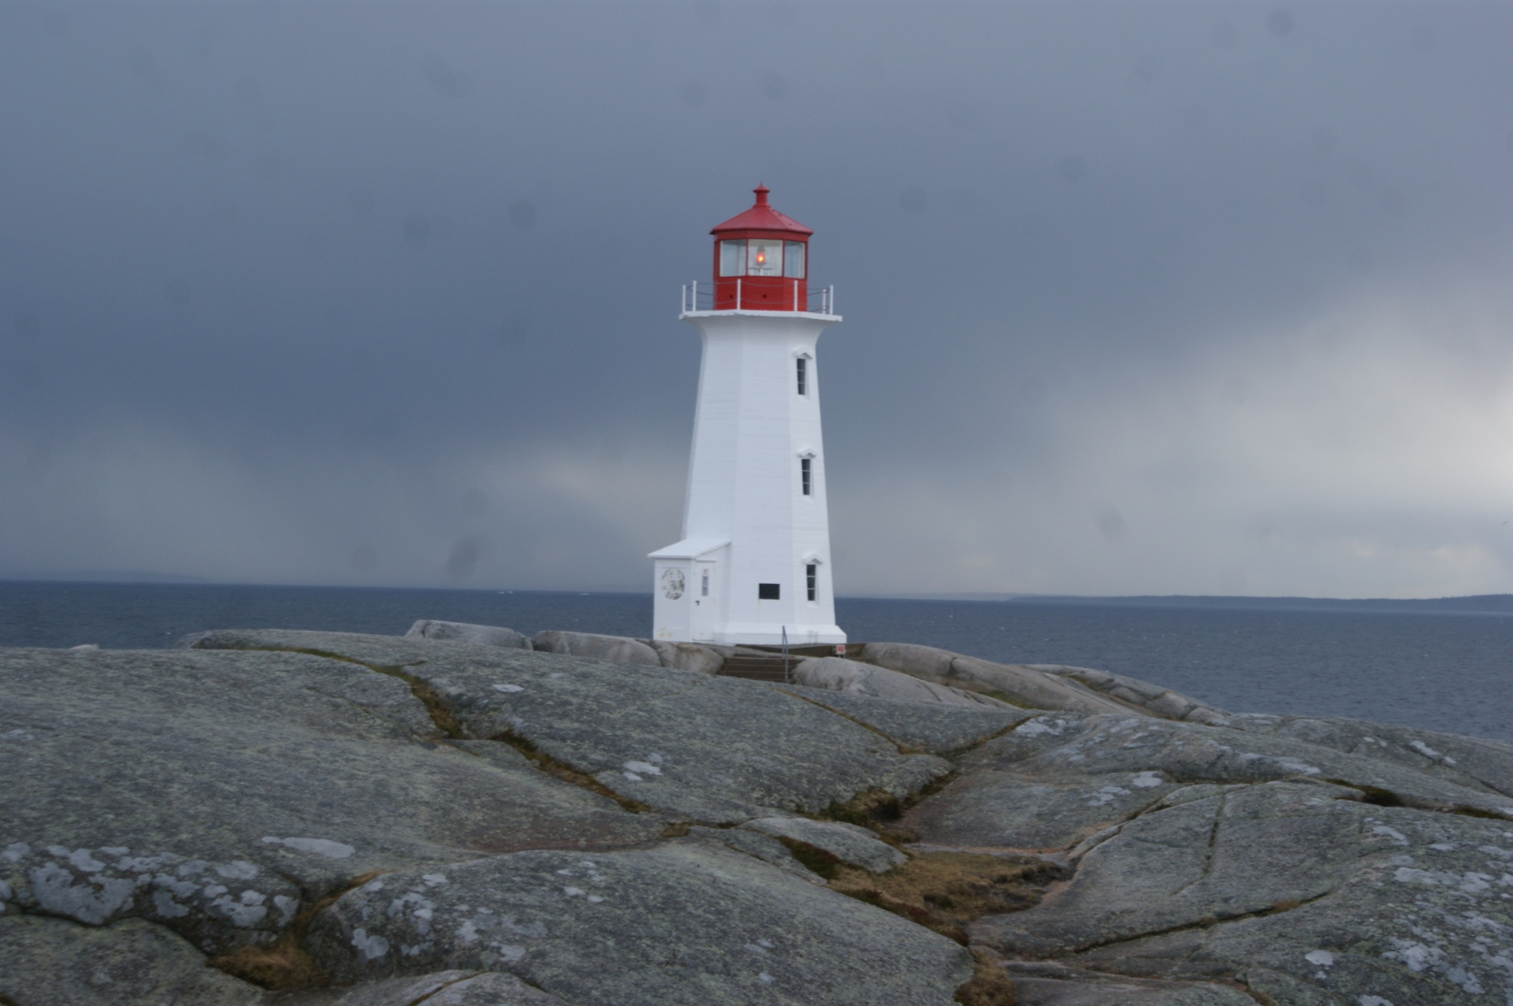
Can-NS-Peggy's Cove Light

Slide 29
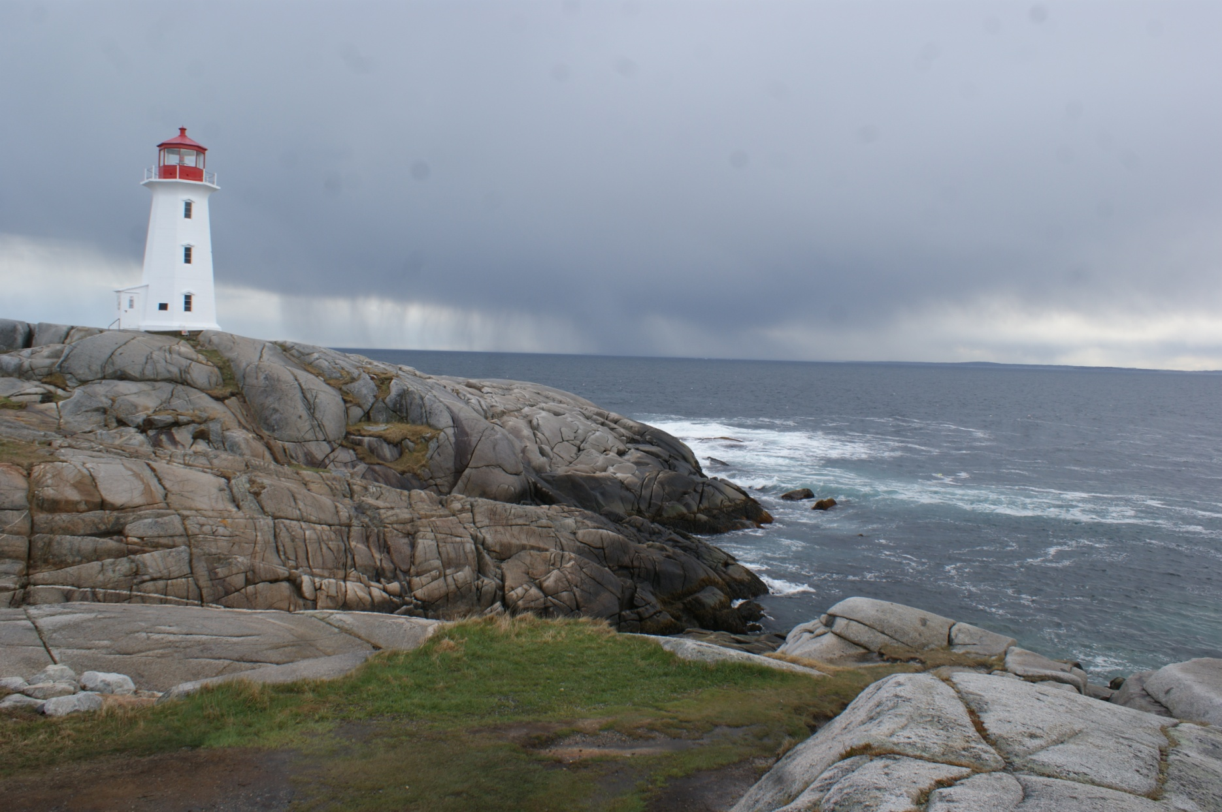
Can-NS-Peggy's Cove

Slide 30
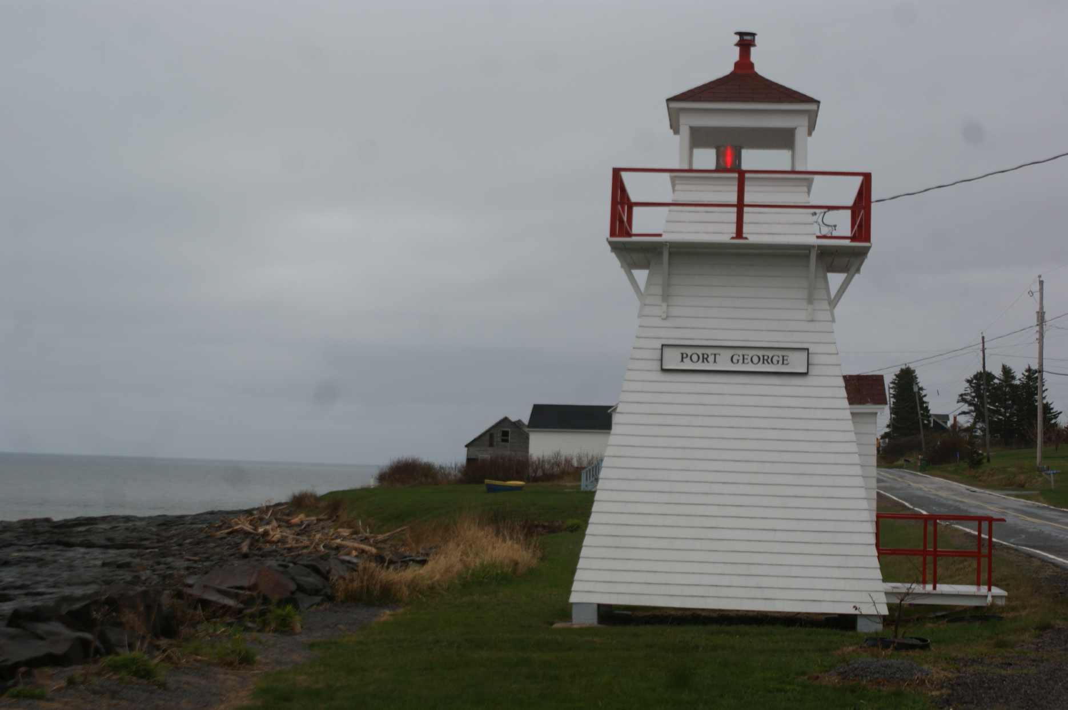
Can-NS-Port George

Slide 31
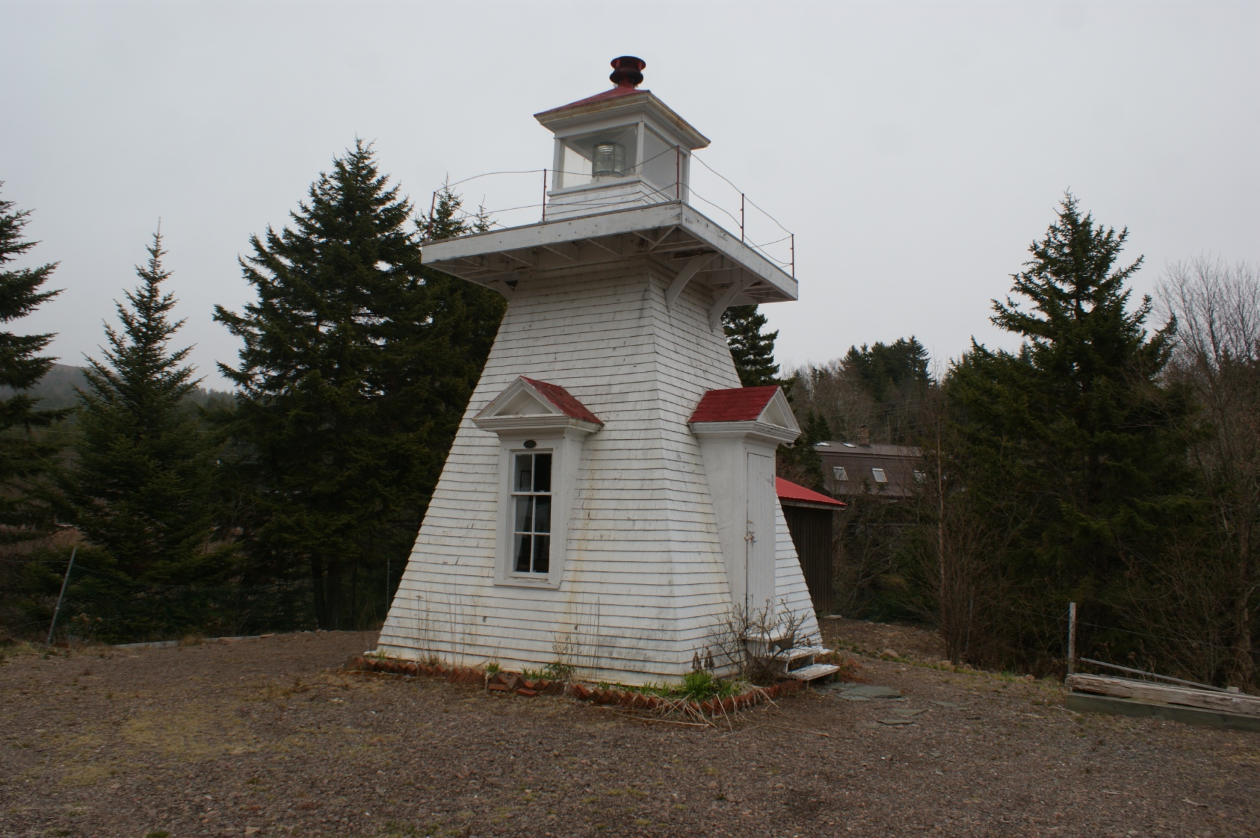
Can-NS-Port Greville

Slide 32
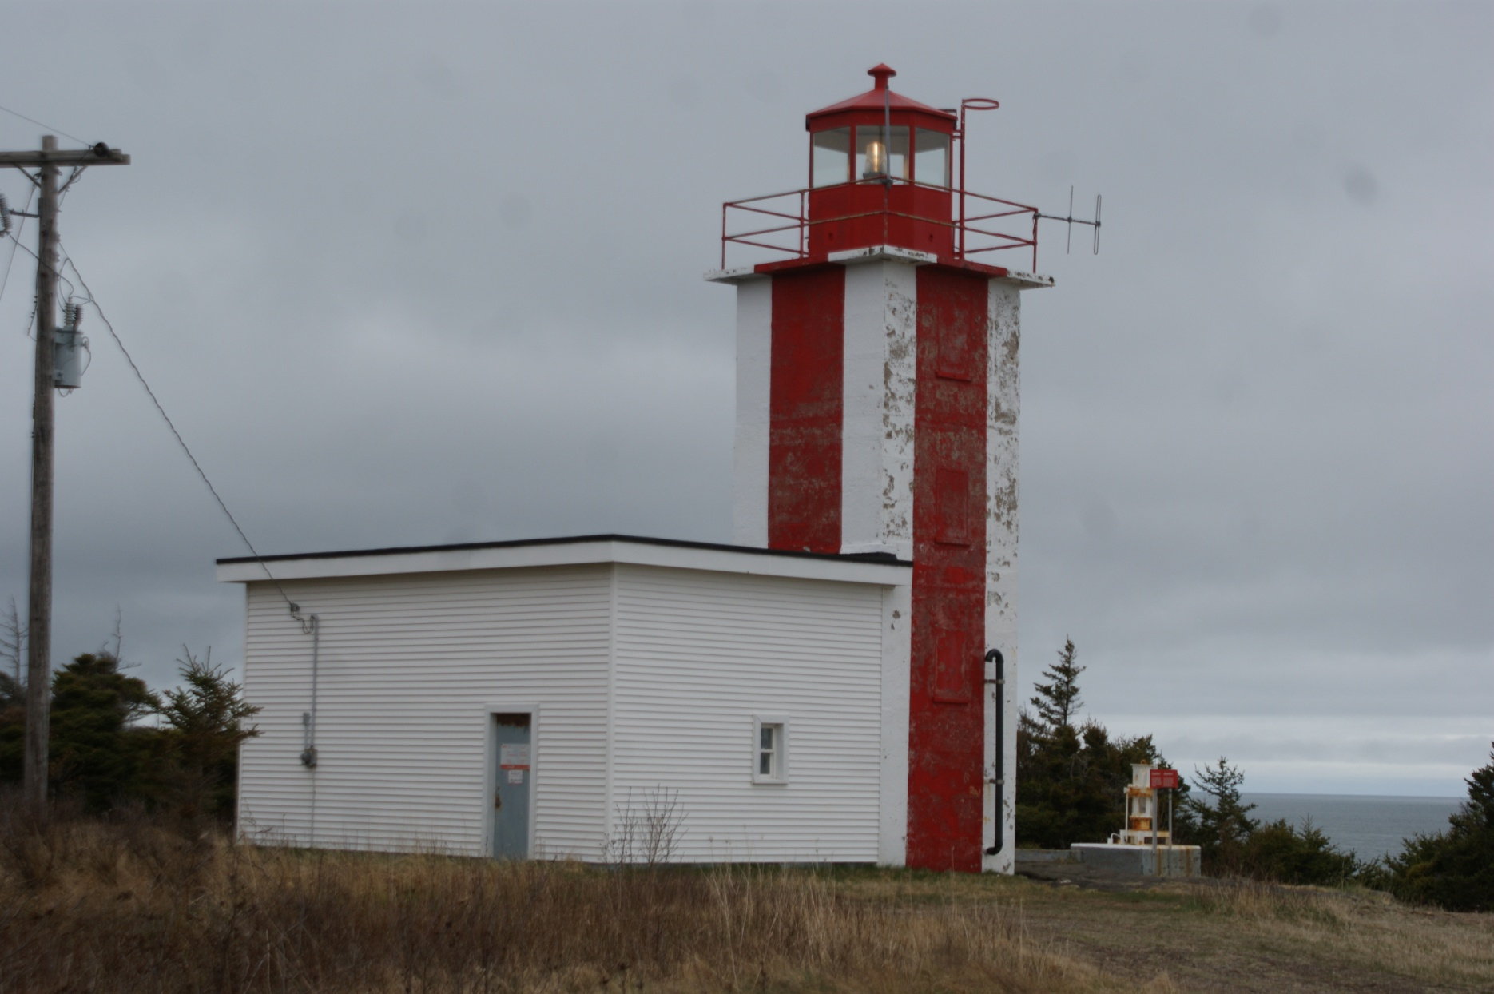
Can-NS-Prim Point

Slide 33
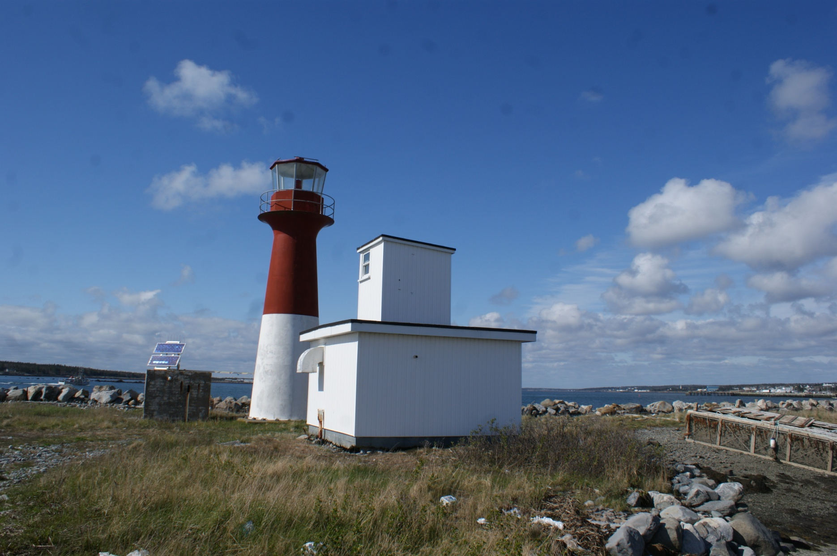
Can-NS-Pubnico Harbour

Slide 34
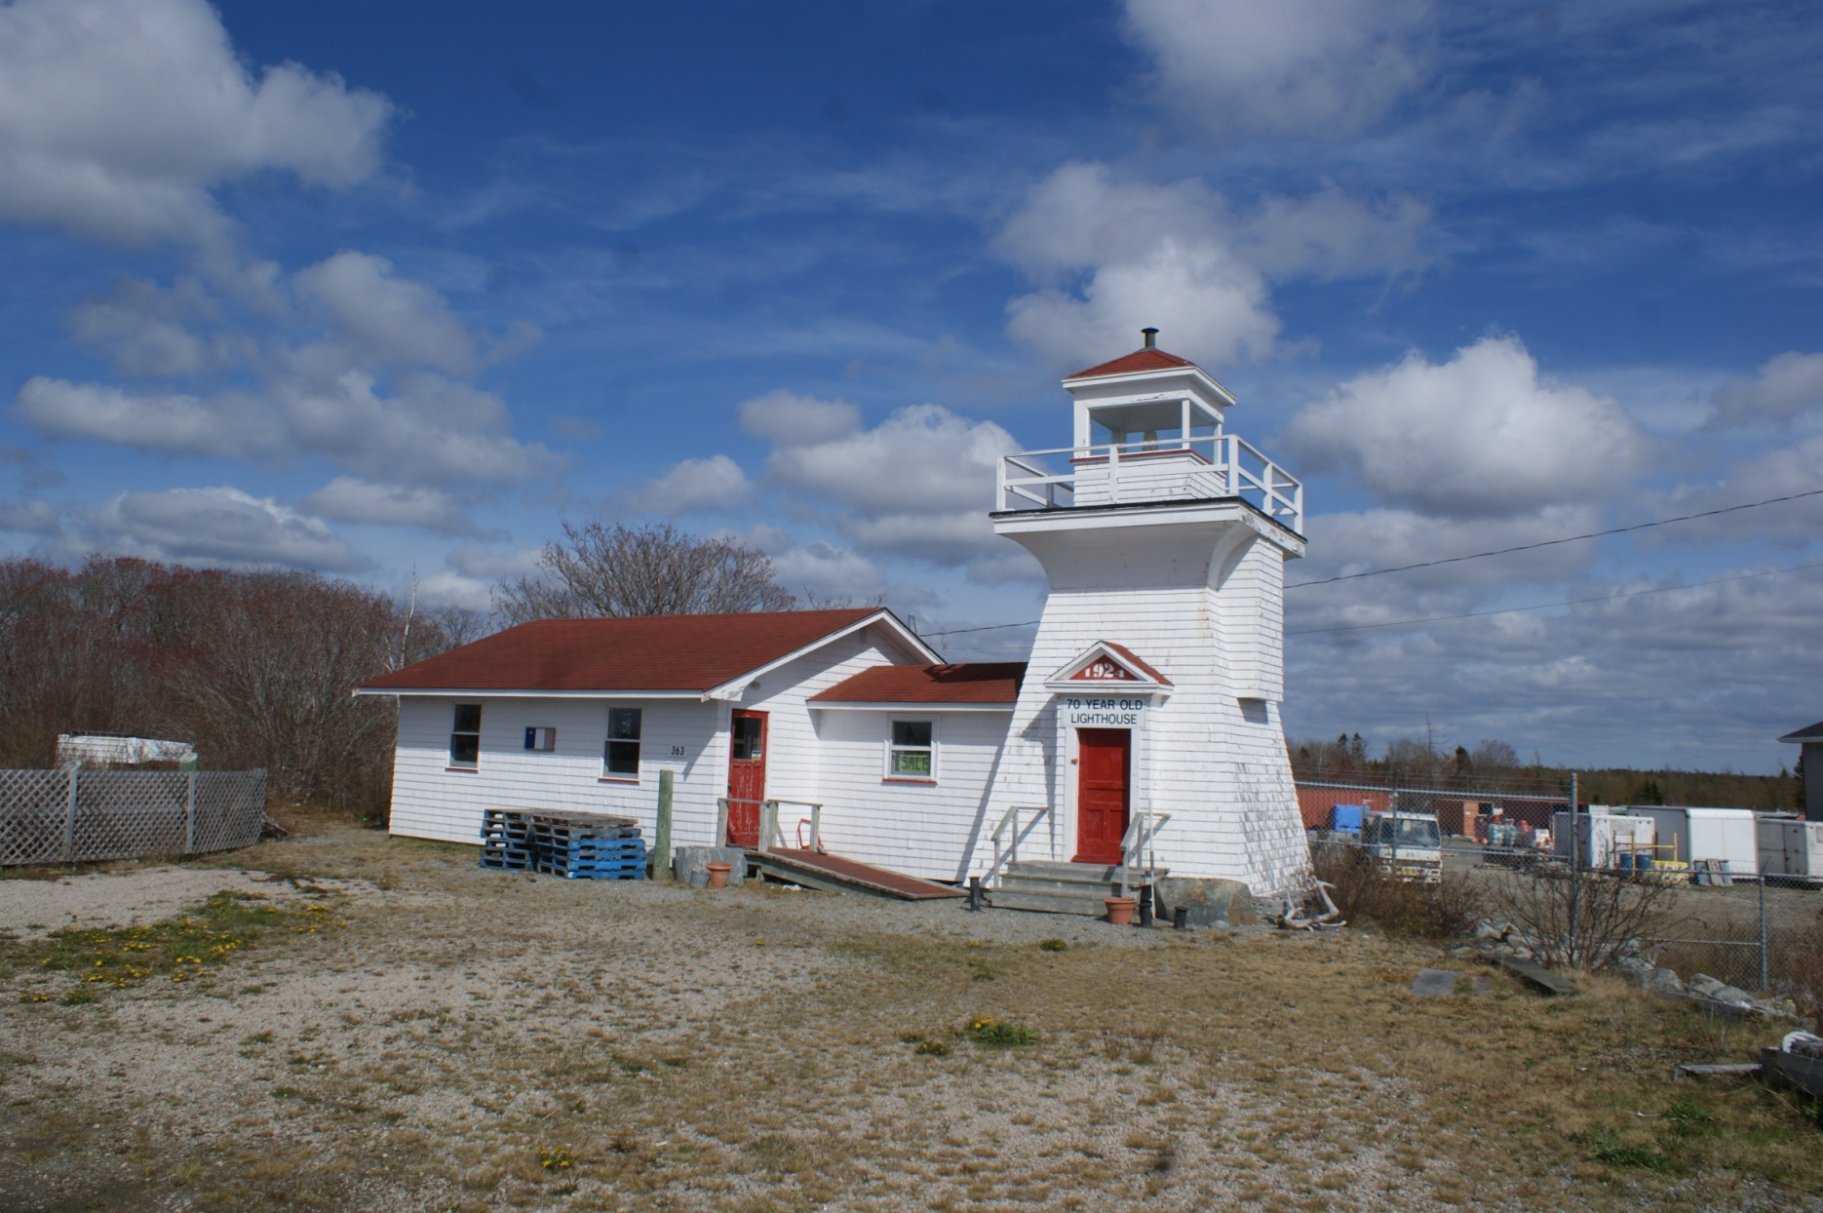
Can-NS-Salmon River

Slide 35
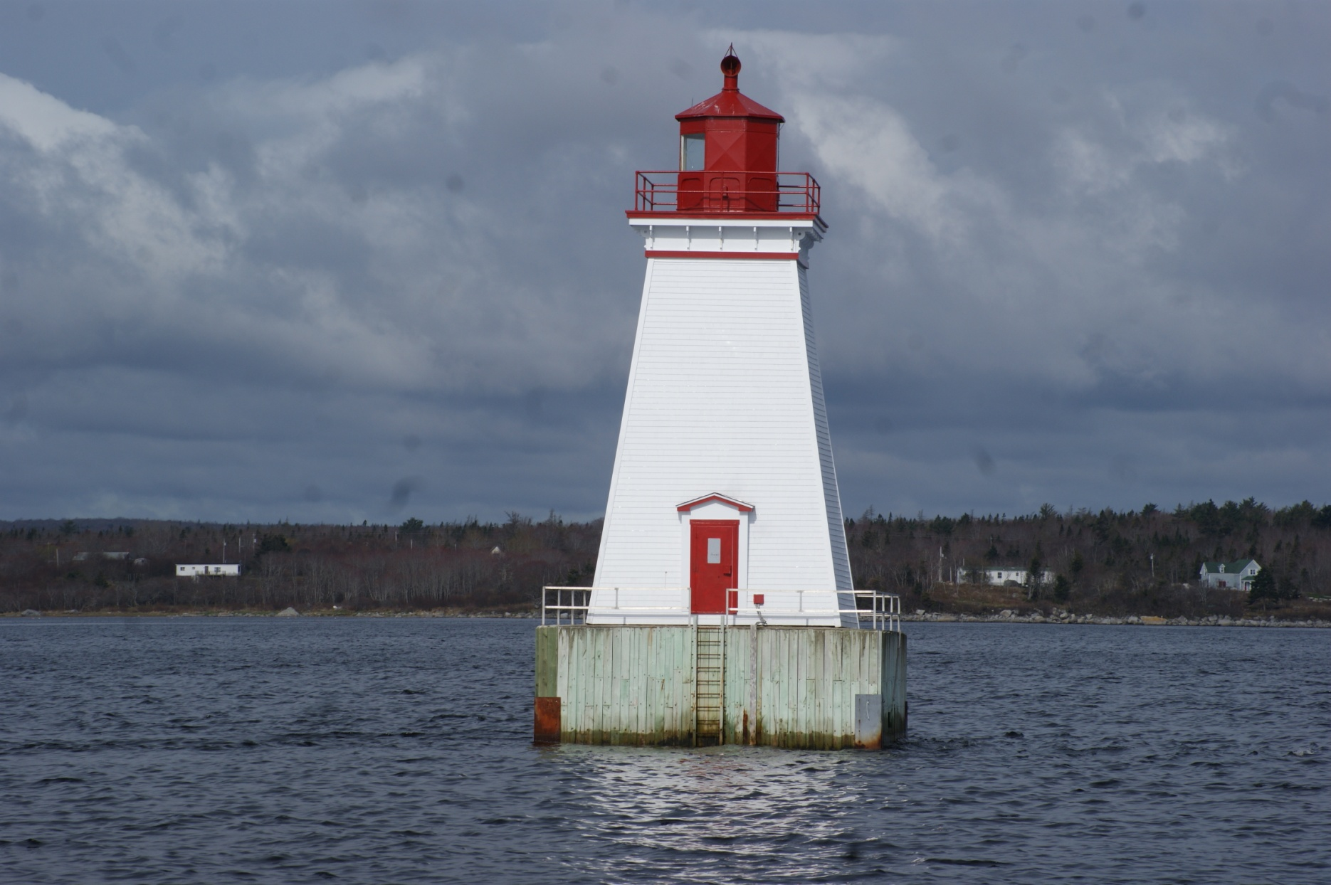
Can-NS-Sandy Point

Slide 36
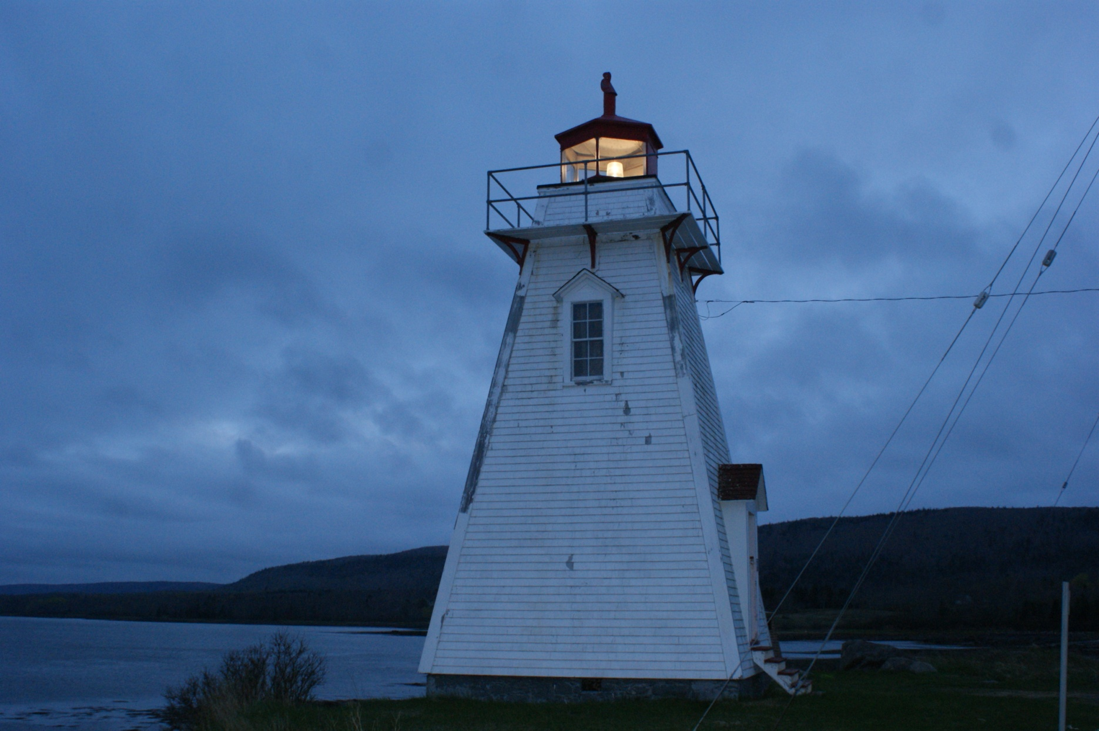
Can-NS-Schafner Point

Slide 37
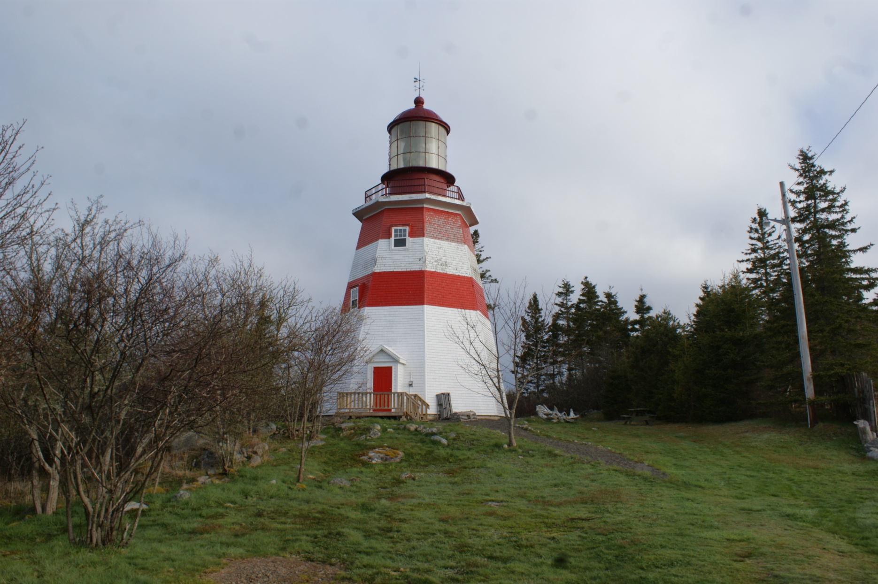
Can-NS-Seal Beach

Slide 38
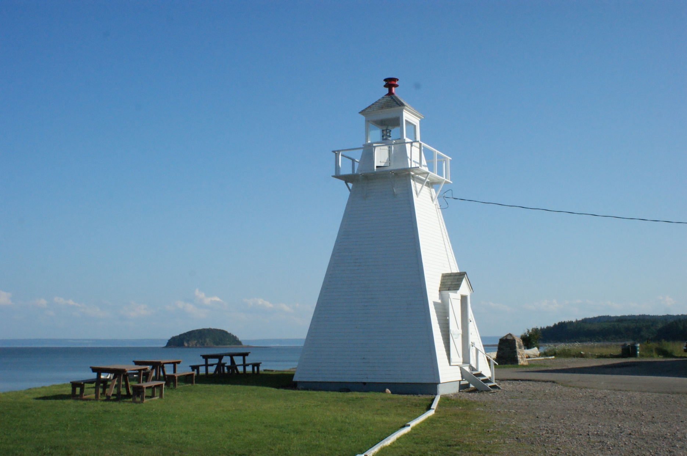
Can-NS-Spencer's Island Lighthouse

Slide 39
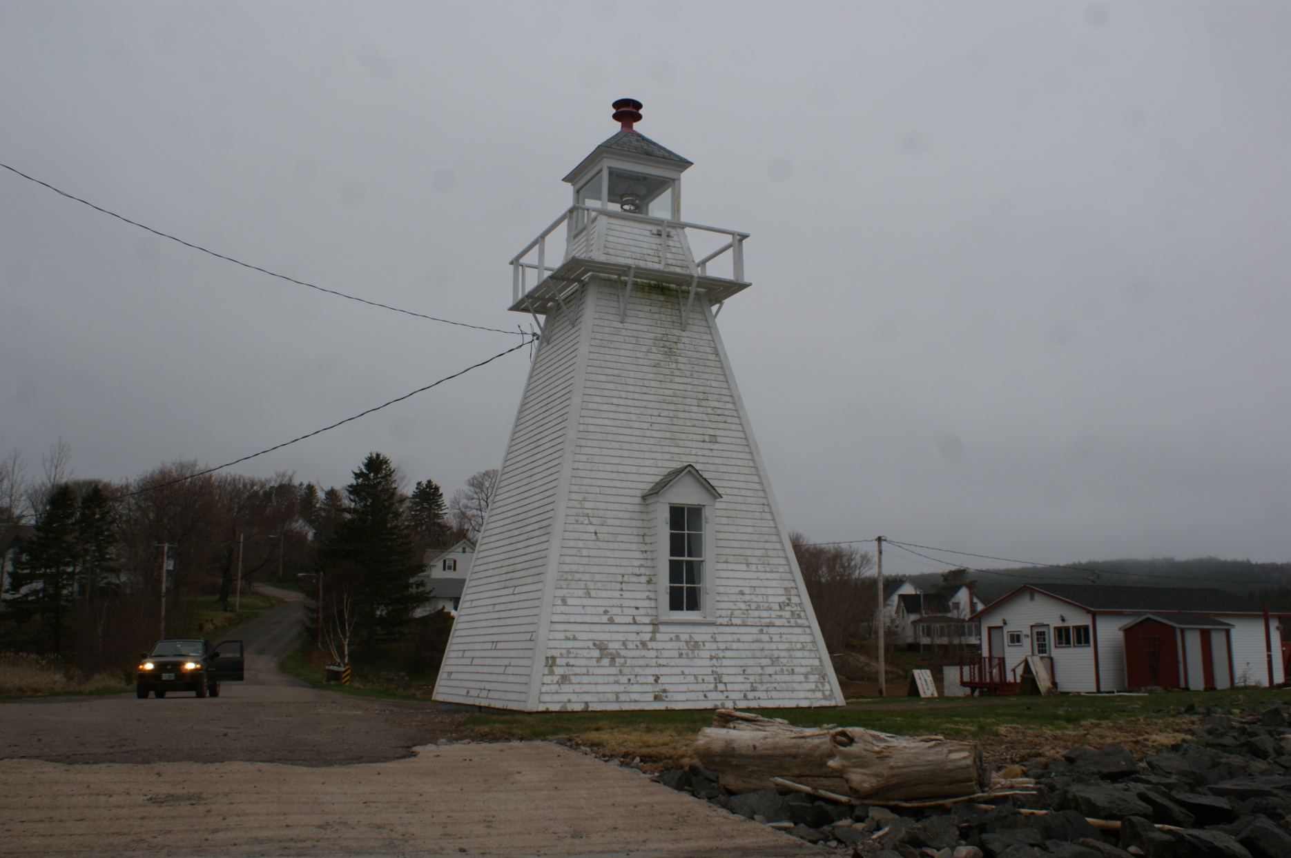
Can-NS-Spencer's Island

Slide 40
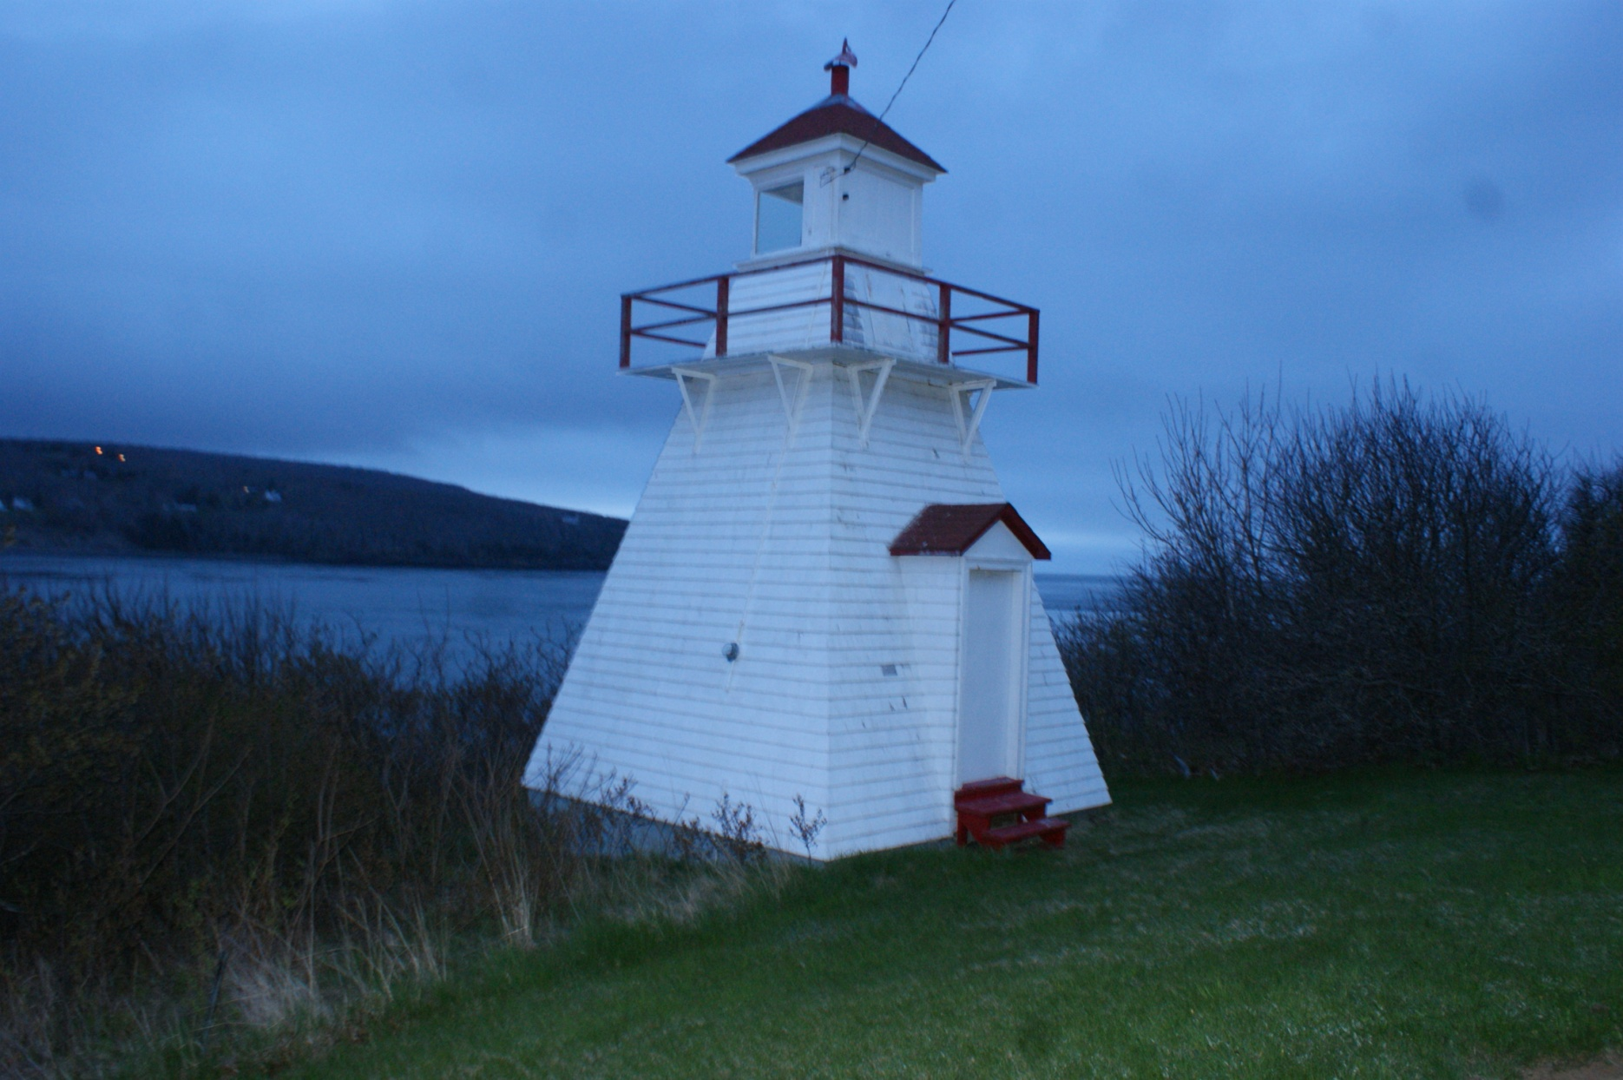
Can-NS-Victoria Beach

Slide 41
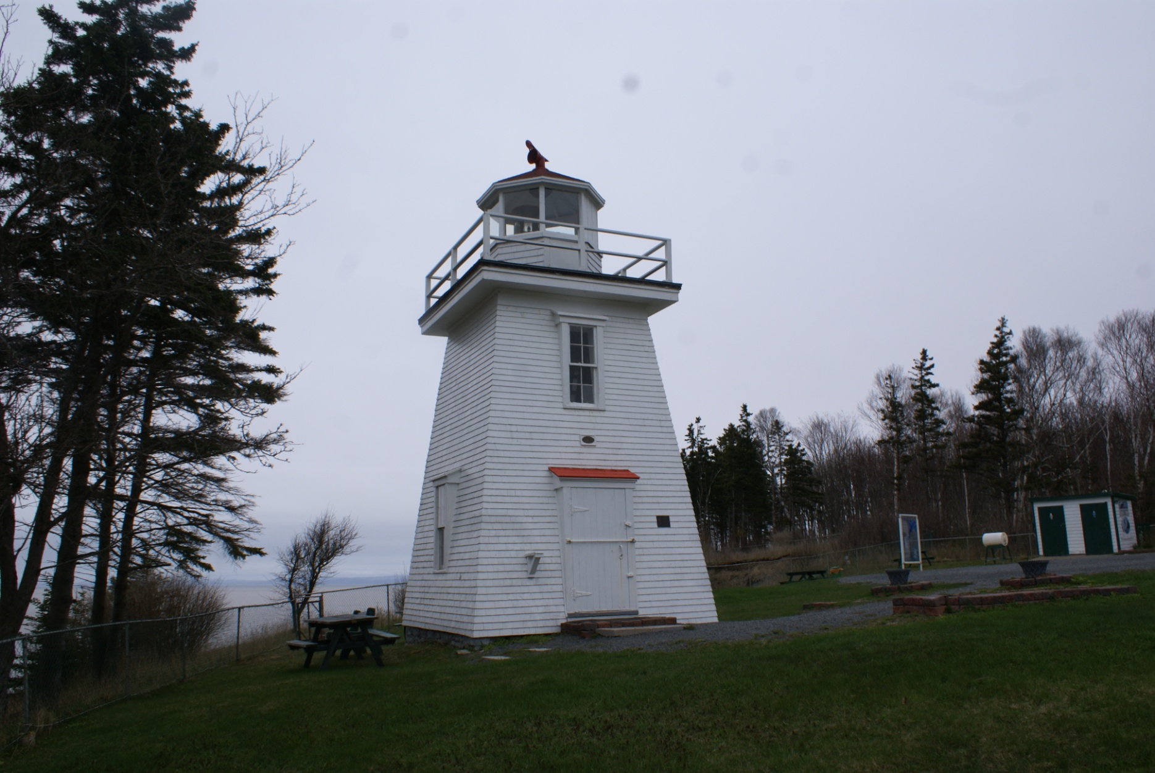
Can-NS-Walton Harbour

Slide 42
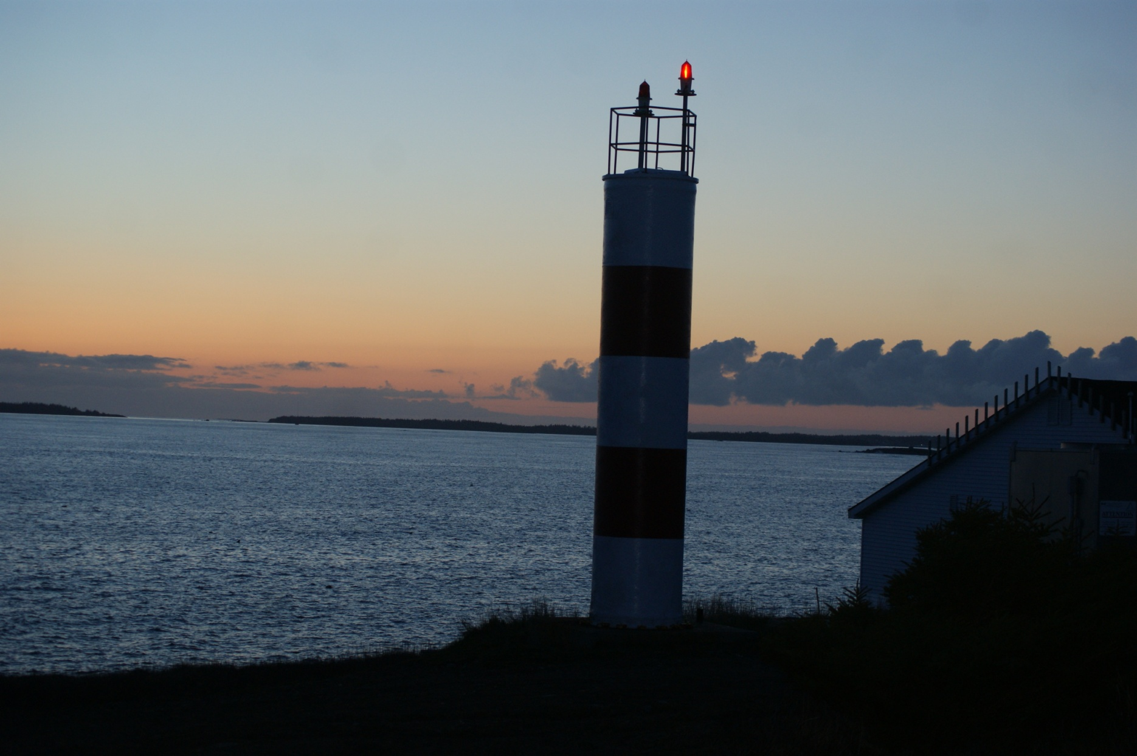
Can-NS-West head

Slide 43
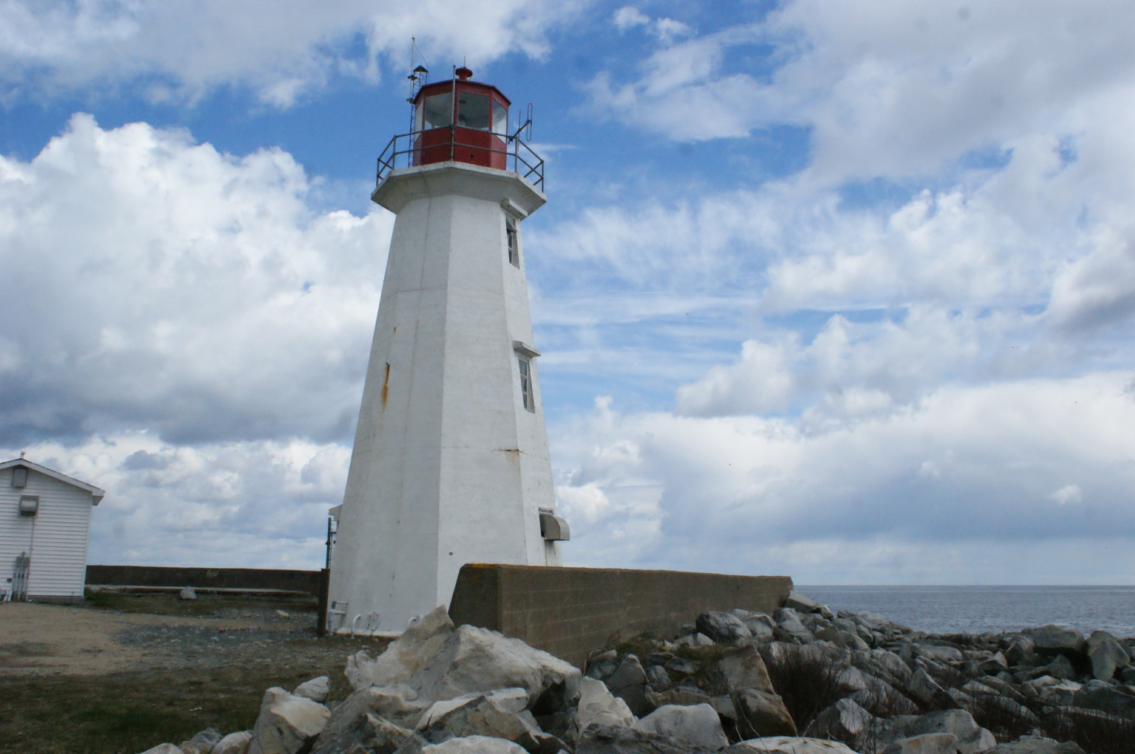
Can-NS-Western Head

